Slide 1
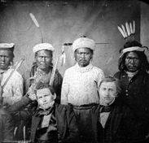
The Maidu
By Caylee
This Photo by Unknown author is licensed under CC BY-SA.

Slide 2
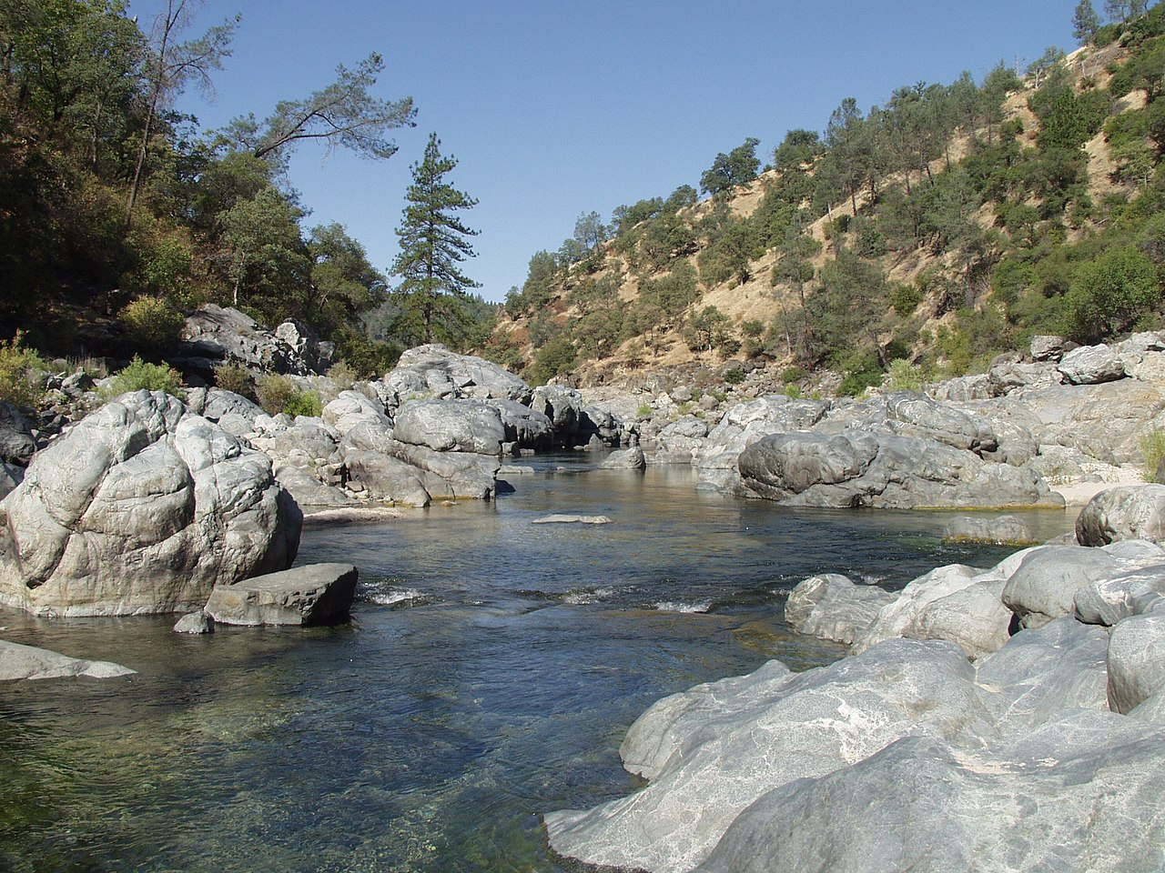
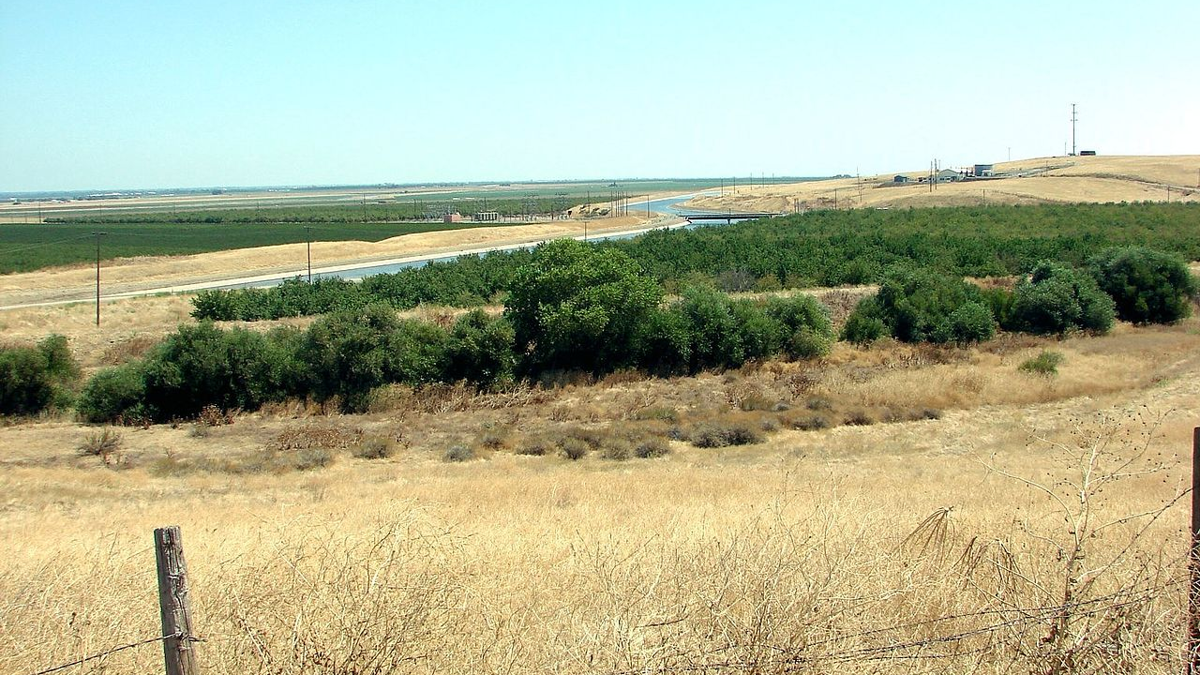
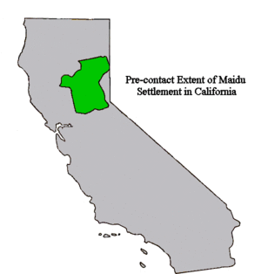
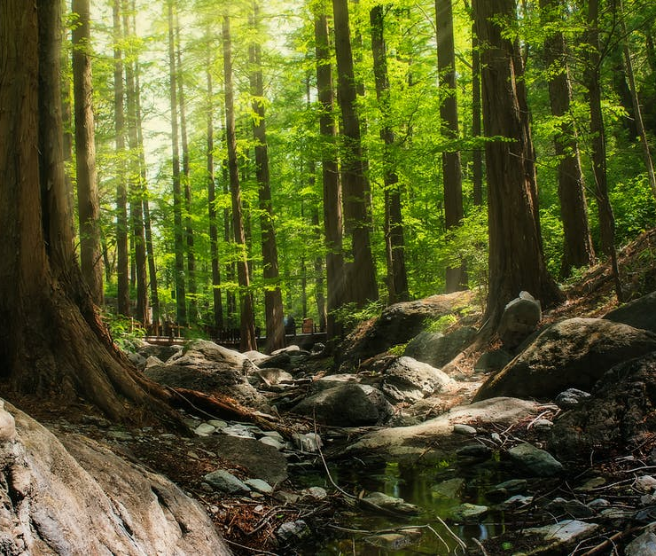
Location
The Maidu lives near the Sacramento valley
They also live near the yuba river. They live
Near mountain areas. The weather is mild.
This Photo by Unknown author is licensed under CC BY-SA.
This Photo by Unknown author is licensed under CC BY-SA.
This Photo by Unknown author is licensed under CC BY-SA.

Slide 3
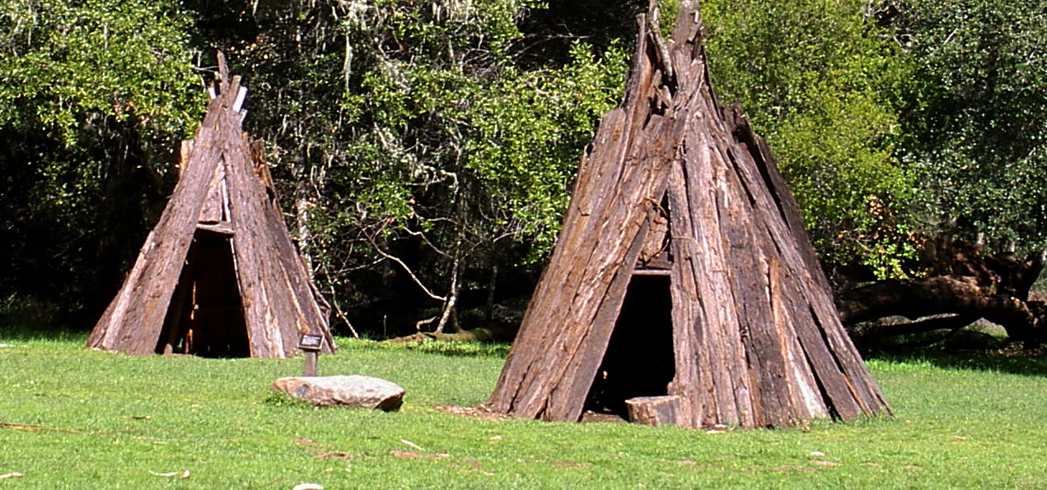
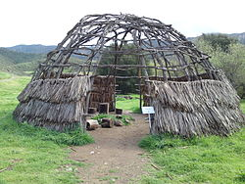
Shelter
The Maidu's home is partly underground.
They have a round house. Their house
Is covered with bark
This Photo by Unknown author is licensed under CC BY-SA.
This Photo by Unknown author is licensed under CC BY-SA.

Slide 4
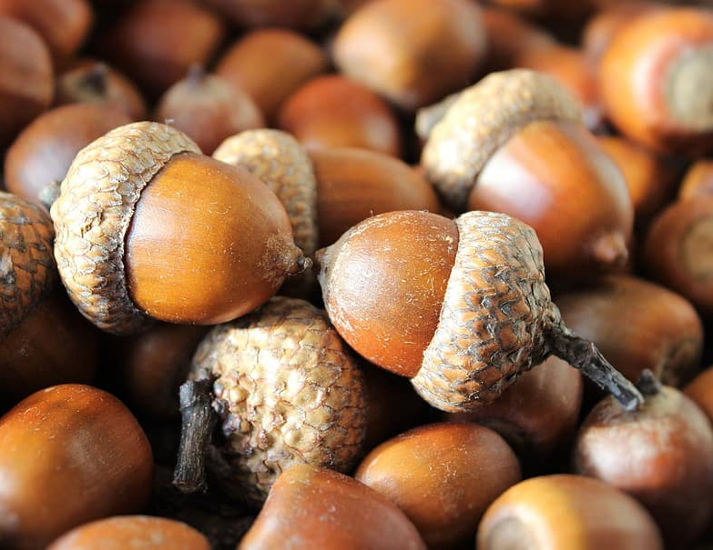
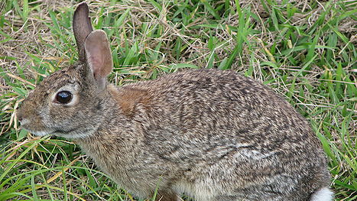
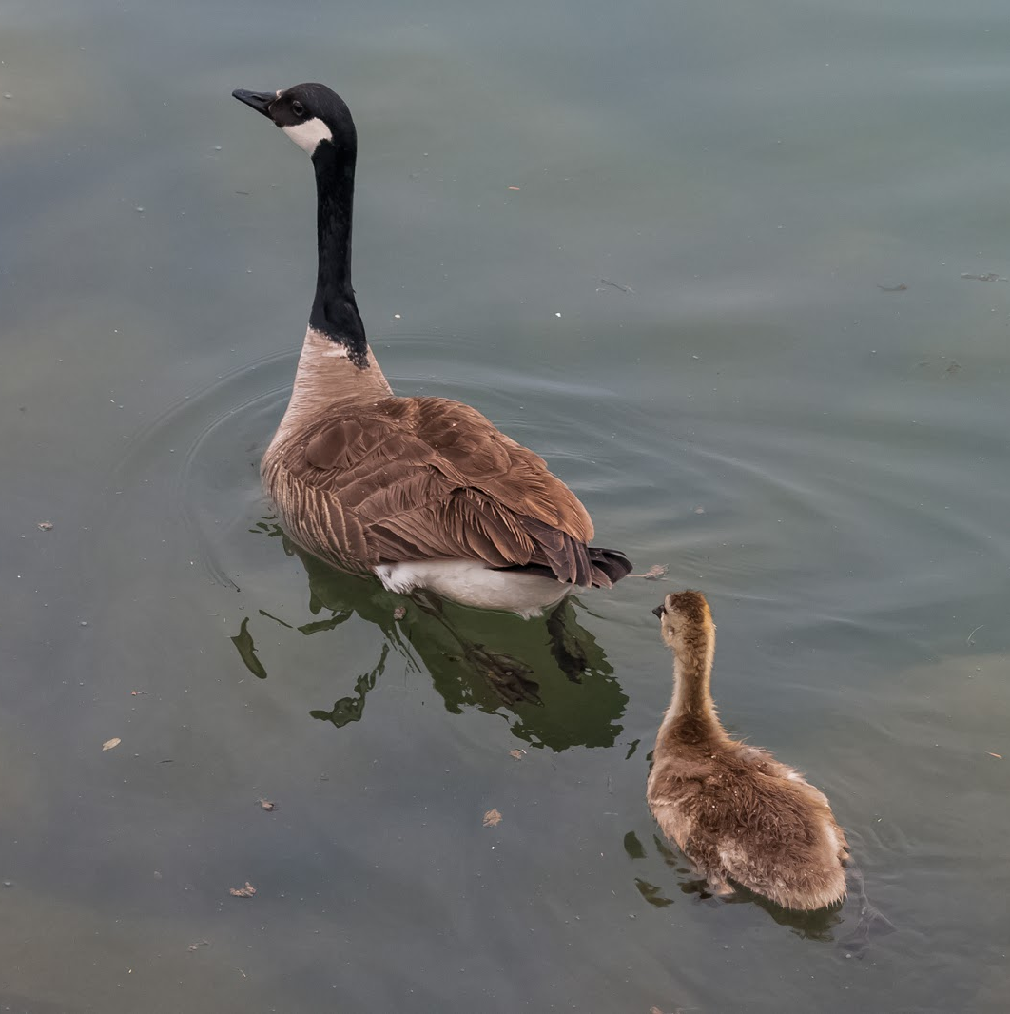
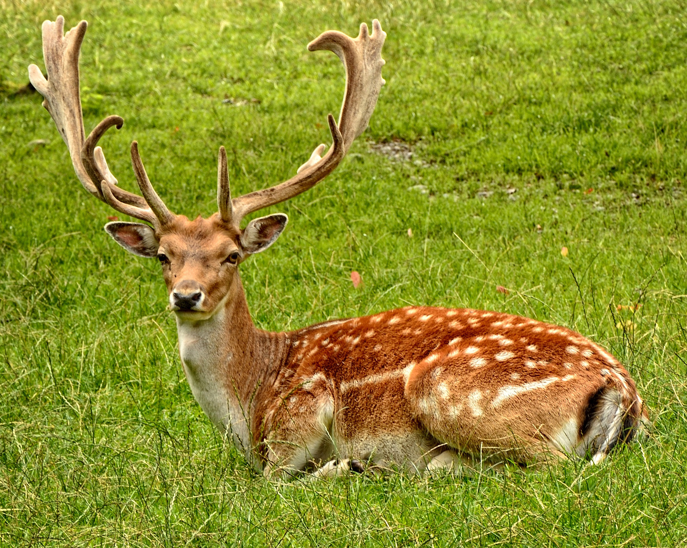
Food
They hunted geese, small rodents, rabbits, and deer.
They ate fruits and caterpillars also crickets
This Photo by Unknown author is licensed under CC BY-SA.
This Photo by Unknown author is licensed under CC BY.

Slide 5
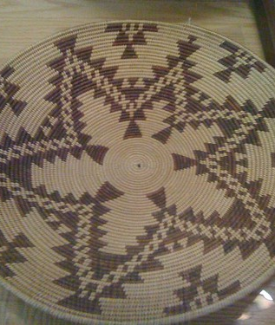
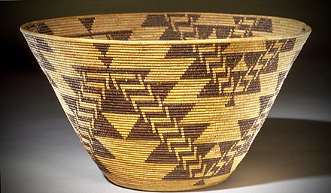
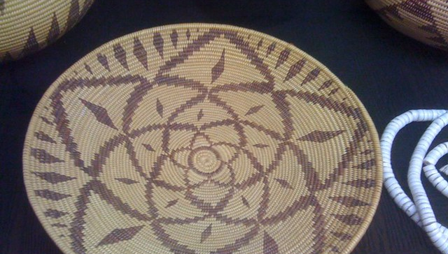
Culture
The Maidu culture spoke the Penutian language.
They wore clothes made from deer skin.
They were excellent basket makers.
This Photo by Unknown author is licensed under CC BY-SA.
This Photo by Unknown author is licensed under CC BY-NC.
This Photo by Unknown author is licensed under CC BY-NC.

Slide 6
