Slide 1
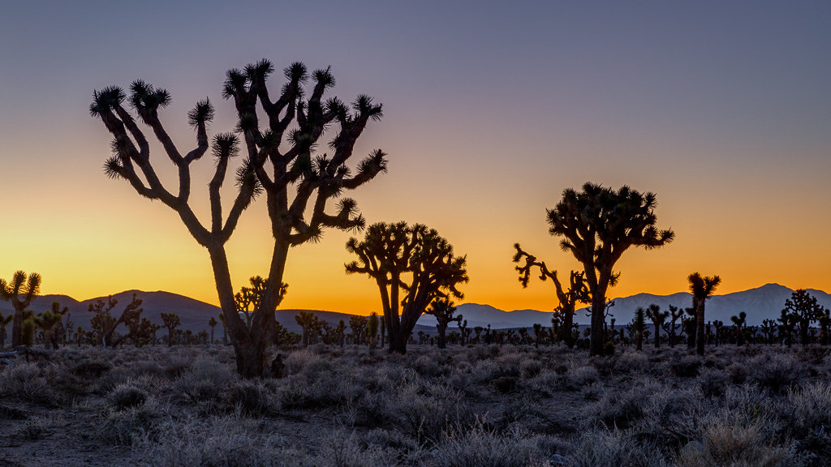
The Mojave Tribe
By Danielle
This Photo by Unknown author is licensed under CC BY-NC-ND.

Slide 2
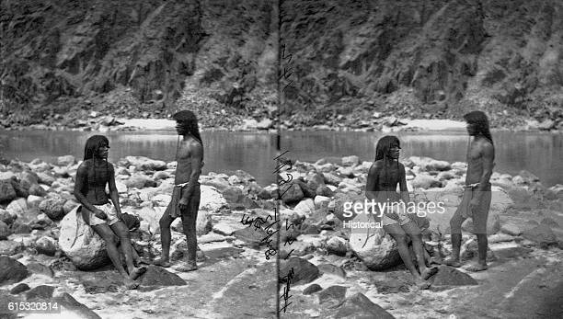
Location
They lived along the lower Colorado river.
The Tribal headquarters is currently in Needels California.
Climate is usually anywhere from 60s- to the 30s.

Slide 3
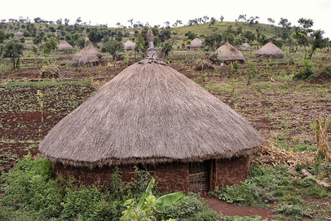
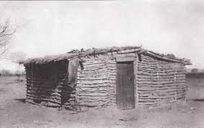
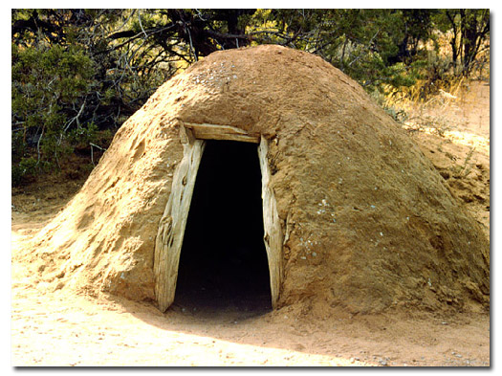
SHELTER
They have 2 different homes, one for the cold season and one for the warmer seasons.
The warmer seasons were raised on stilts to protect from flooding ,the frames were built with wooden frames covered with grass or brush.
In the colder months they were made with clay to keep warm.
They were called huts.

Slide 4
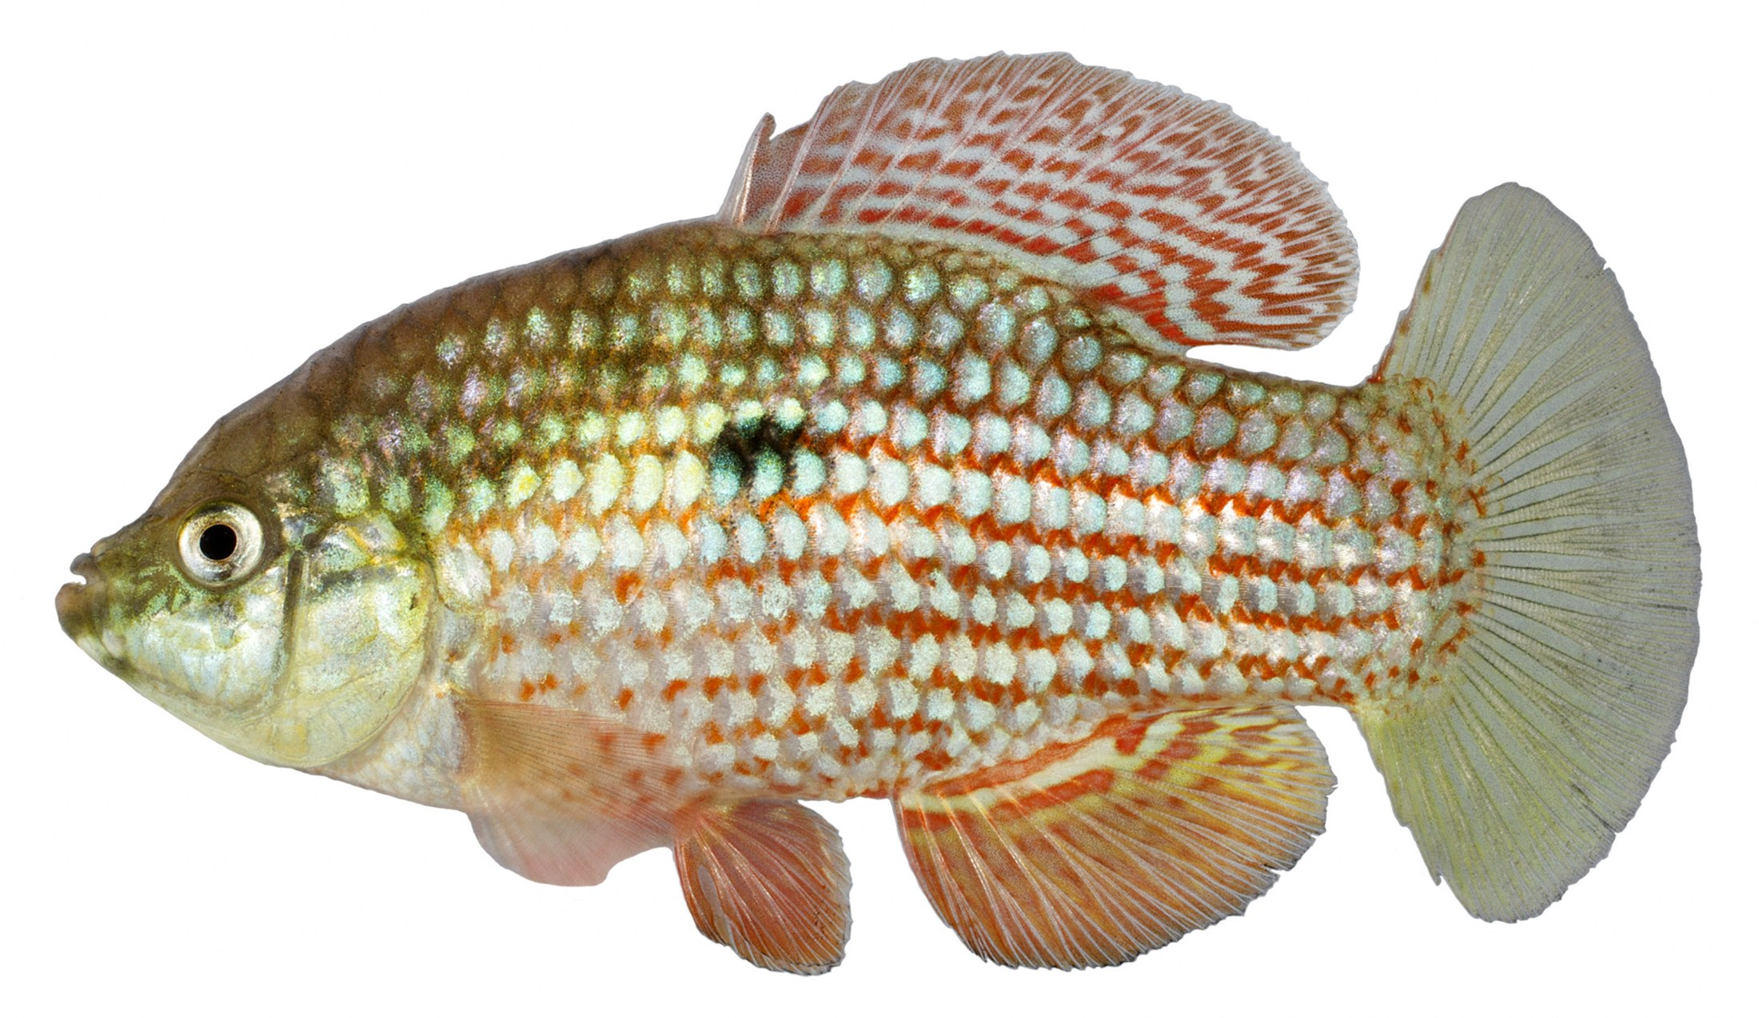
food
They fished for their food and used boats they made to go to different spots.
They were good at fishing, hunting, and skilled farmers.
They ate beans, squash, corn, pumpkins.
They did a rain dance to help bring rain for their crops.

Slide 5
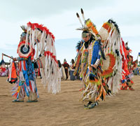
Culture
They spoke yuman.
They wore simple loin clothing from beaver and rabbit.
Mojave means the people who live by the river.
They were very religious and spiritual. they were mainly barefoot or wore sandals.
Bead work, tattoos from blue cactus, tattooed slave's chins.

Slide 6
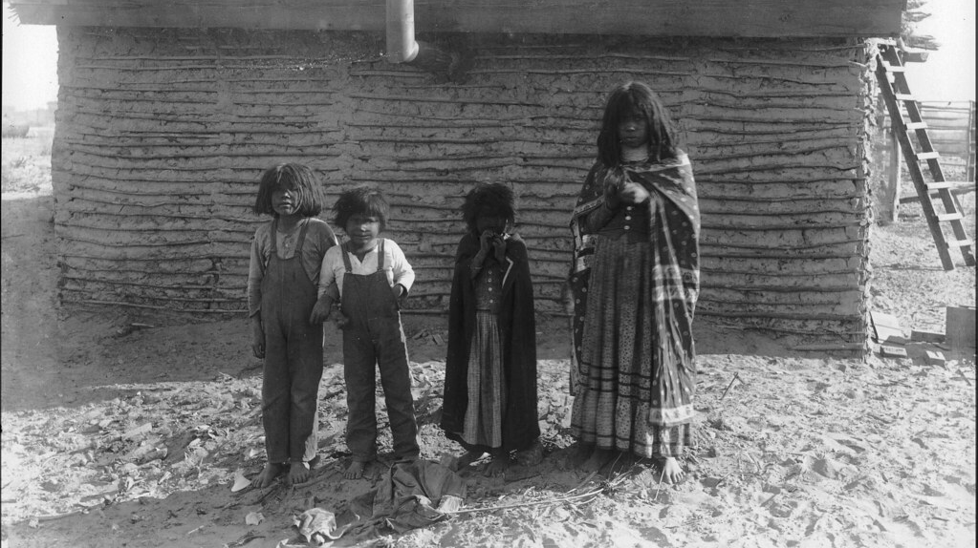
This Photo by Unknown author is licensed under CC BY.

