Slide 1
AIM: What is political geography?
DO NOW: Label Maps of Europe & Asia!
(the best you can)

Slide 2
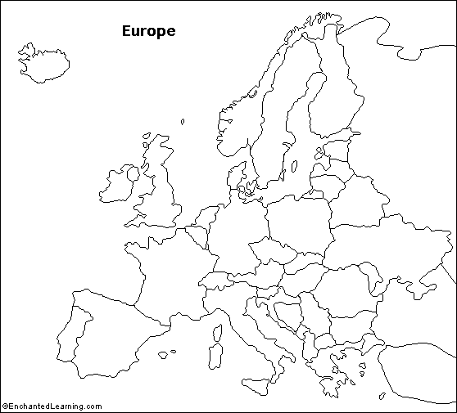

Slide 3
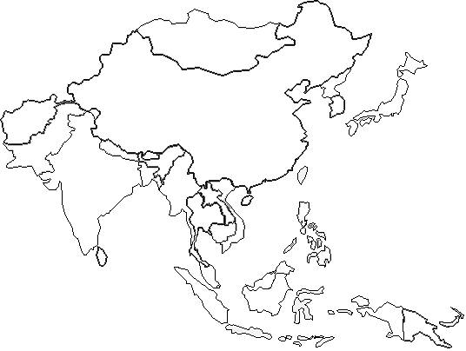

Slide 4
POLITICAL GEOGRAPHY
Old-Style Geography – memorization of countries and their capitals
Human Geographers – location of activities in the world, the reason for particular spatial distributions, and the significance of the arrangements
Still need to know where countries are – otherwise you will lack this frame of reference

Slide 5
Political Geographers – study how people have organized Earth’s land surface into countries and alliances, reasons underlying the observed arrangements, and the conflicts that result for the organization
Geopolitics: The study of the interplay between international political relations and the territories in which they occur.

Slide 6
STATES
an area organized into a political unit and ruled by an established government that has control over its internal and foreign affairs
occupies a defined territory on Earth and contains a permanent population
Aka Country

Slide 7
SOVEREIGNTY
The political authority of a state to govern itself

Slide 8
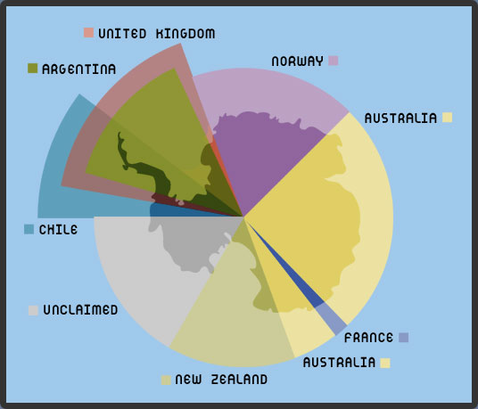
Defining States
ANTARCTICA: Only large landmass that is not part of a state

Slide 9
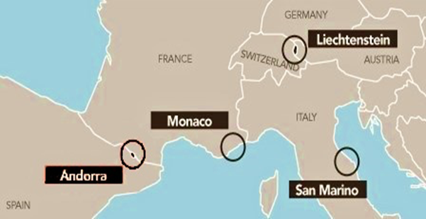
Microstate
Ministate: A country that is small in both population and area.
Andorra, Monaco, Liechtenstein, Singapore

Slide 10
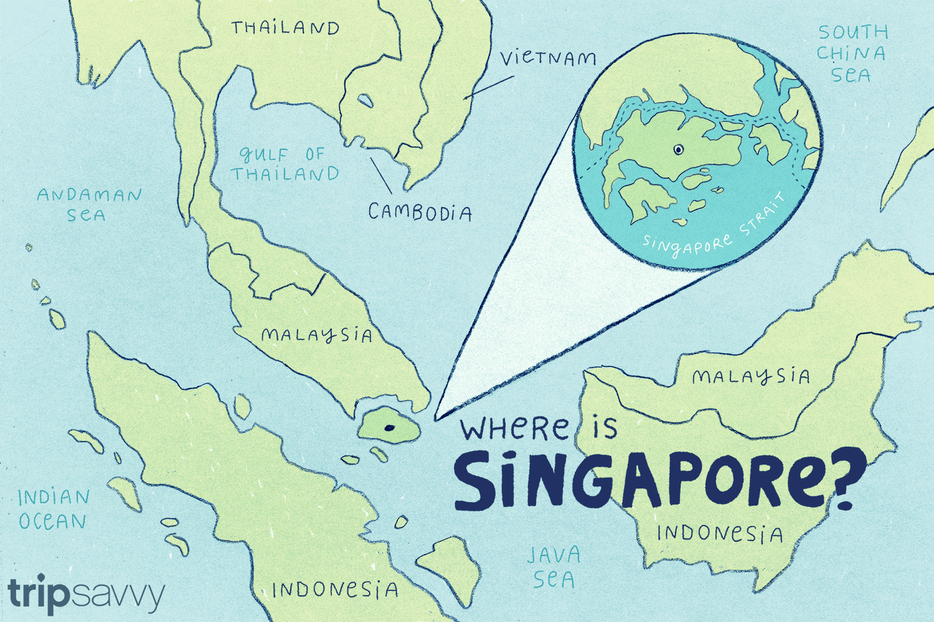

Slide 11
NATION
A group of people bound together by some sense of a common culture, ethnicity, language, shared history, and attachment to a homeland
the French, Koreans, Mexicans
Kurds, Native American tribes

Slide 12
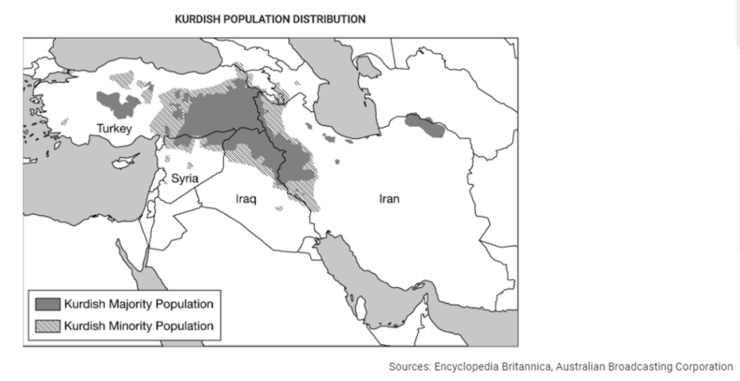

Slide 13
State vs. Nation
STATE
POLITICAL UNIT
Independent country
Defined boundaries
Internationally recognized
Full sovereign control over land and people within boundaries
NATION
CULTURAL UNIT
Common ancestry occupying a particular territory
Common religion (usually) and/or language, accepted behaviors

Slide 14
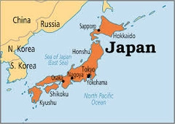
Nation-State
A state in which the cultural borders of a nation correspond with the state borders of a country
Territory matches culture
Examples: Japan, Iceland, Denmark

Slide 15
State-less Nation
A nation of people without a state that it considers home
Kurds, Basques, Palestinians

Slide 17
Multinational State
A state that contains more than one nation, and no single ethnic group dominates the population
Every state to a degree is multinational (no state has 100% of a single ethnicity)
Examples: former Yugoslavia, former USSR, Lebanon

Slide 18
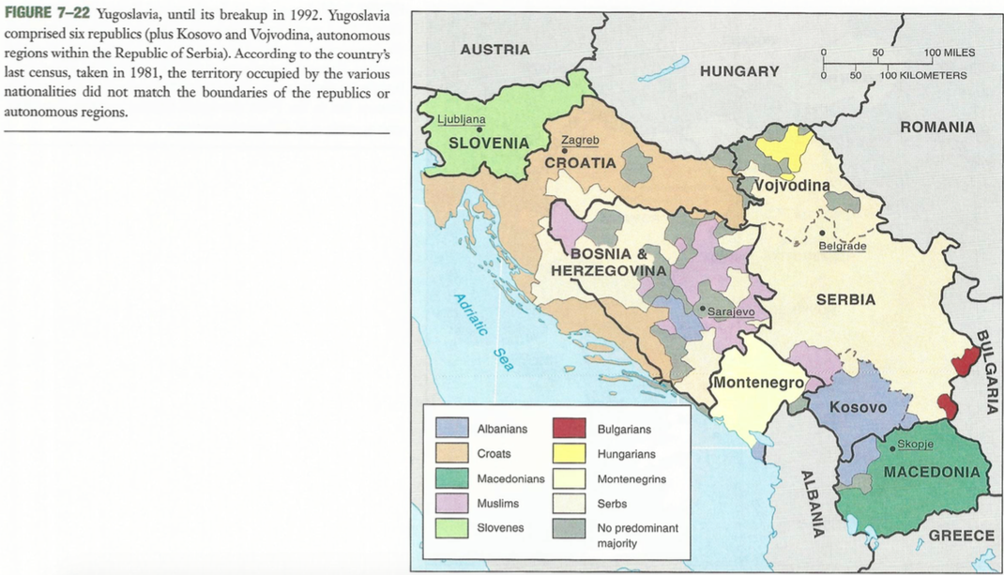

Slide 21
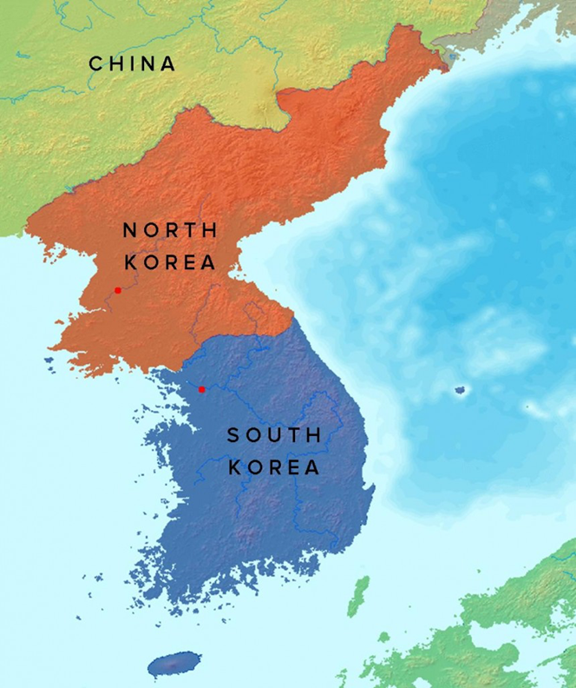
Multi-state Nation
Nation stretches across borders and across states
people share a common characteristic and live in multiple states.
Example: Kurds, Koreans

Slide 22
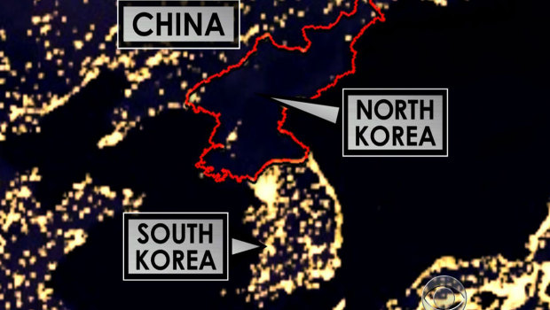

Slide 23
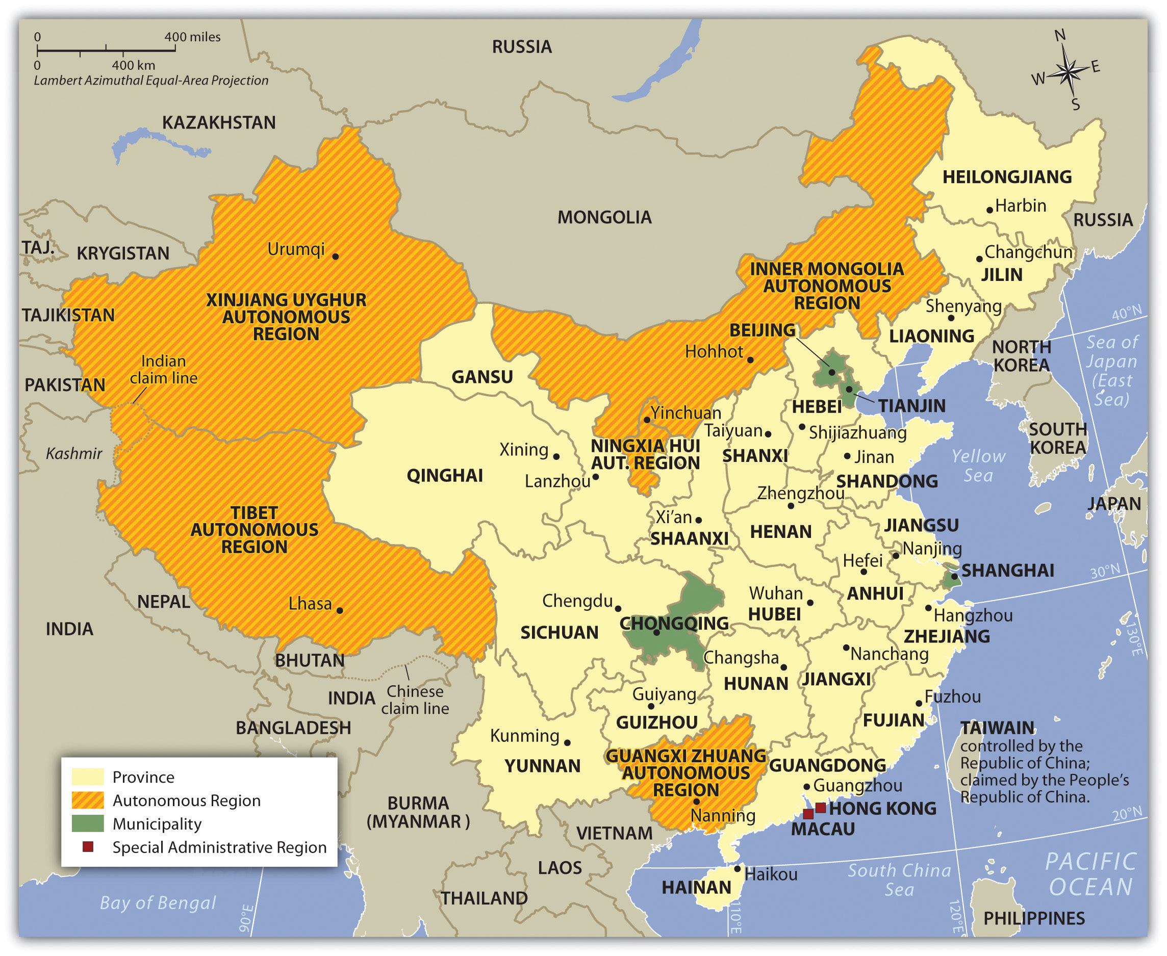
Autonomous region
sections of a nation that have a degree of independence in several issues.
control over certain affairs, make own decisions

Slide 24
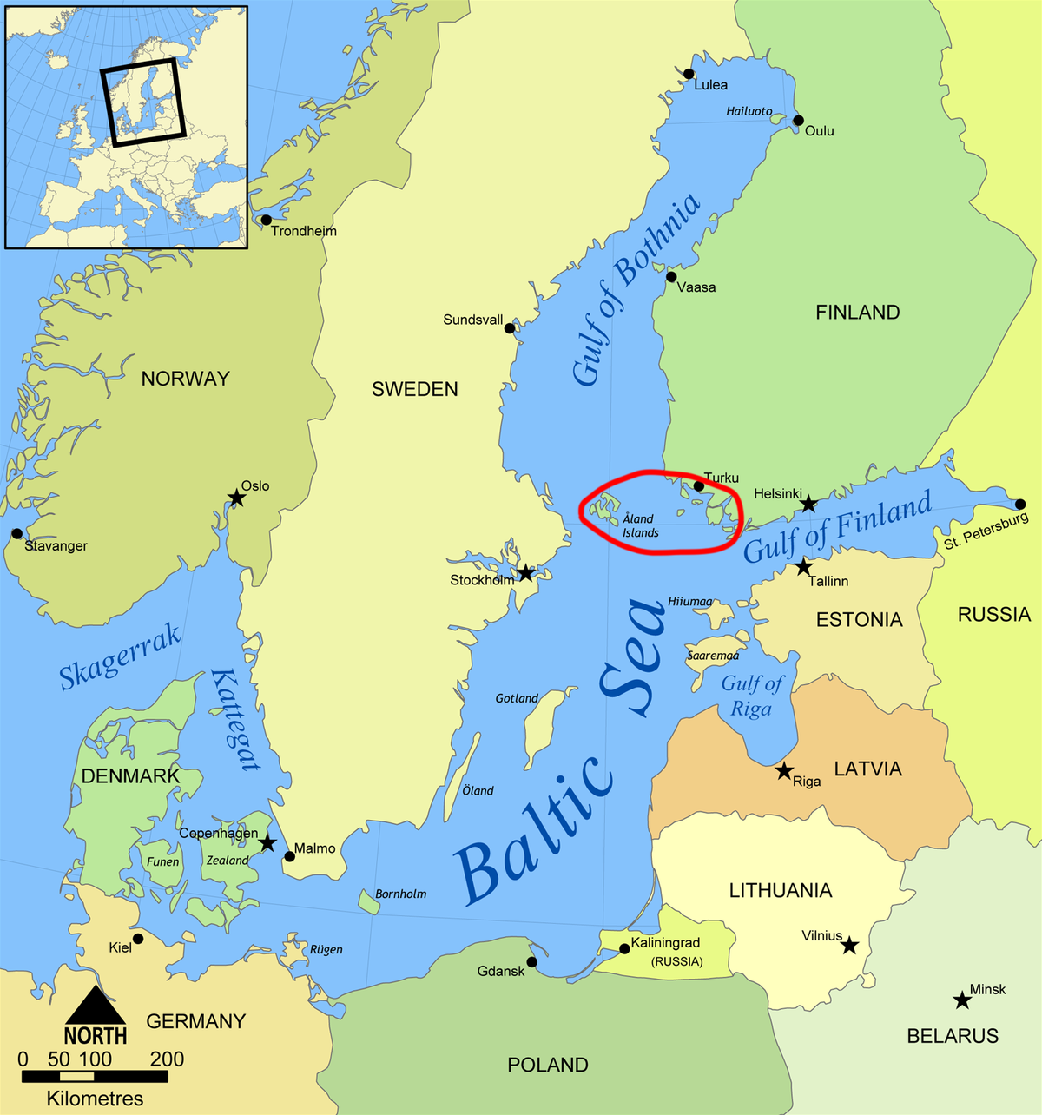
Autonomous region
An area may be granted autonomy if it is situated in a sizable distance from the rest of the nation or if the population of the area consists primarily of minority communities.
Examples: many regions in China, Aland islands

Slide 25
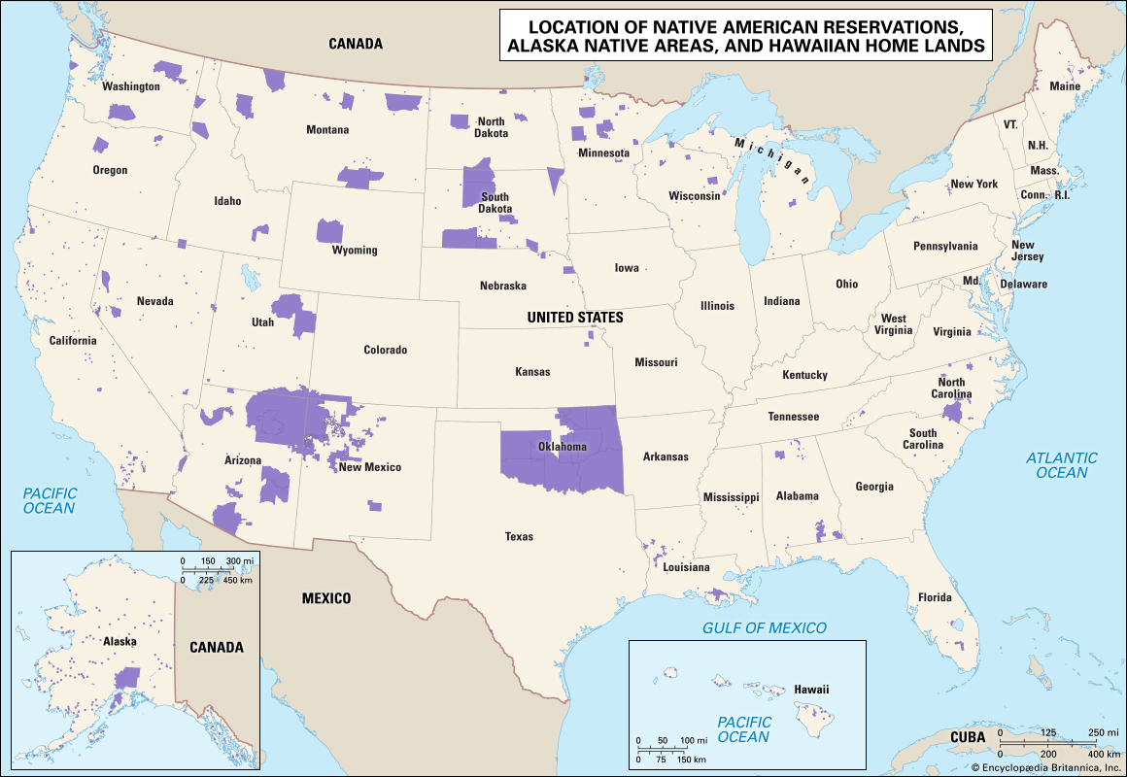
Semi-Autonomous region
having a degree of, but not complete, self-government.
Example: Native Americans

Slide 26
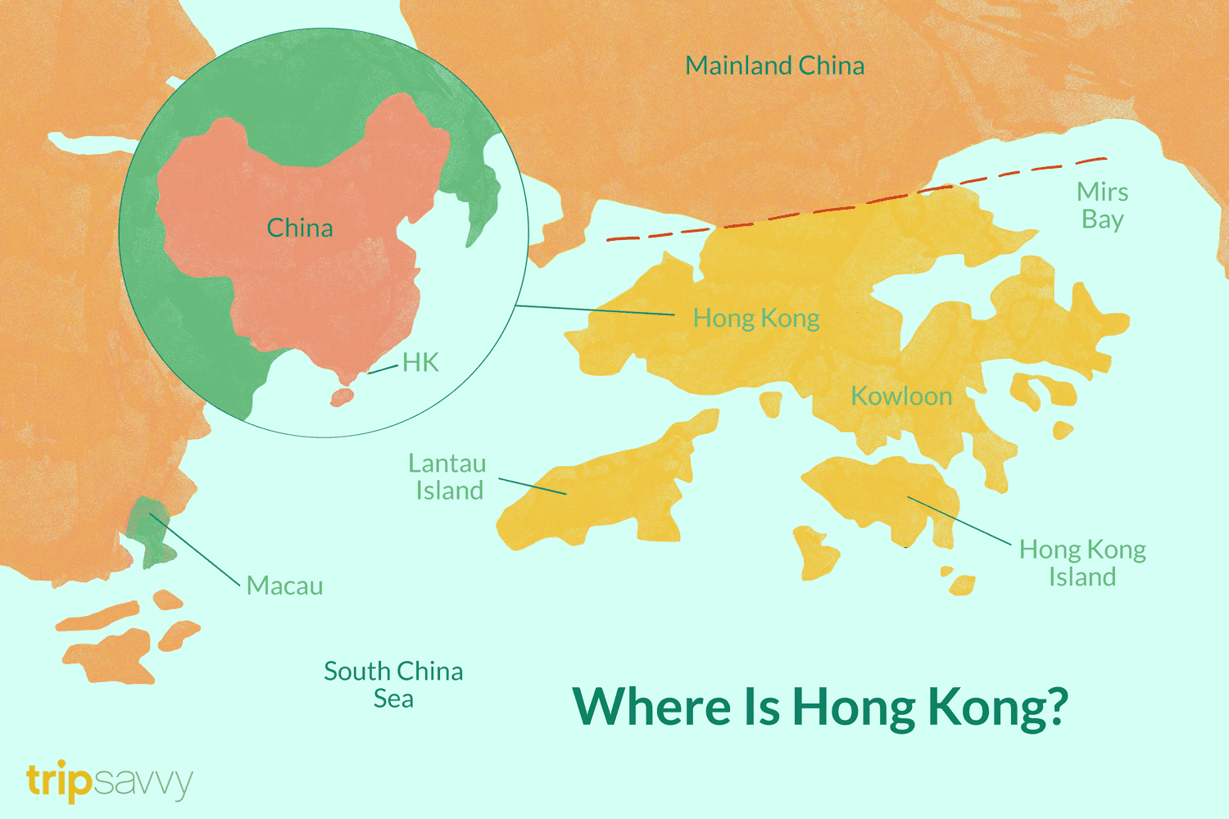

Slide 27
https://www.fpri.org/wp-content/uploads/gravity_forms/9-783cbbb3cd8d887559185fd5a9430e51/2018/01/Types-of-States-Lesson-Craig-Gaslow-AP-Human-Geography-2-1.pdf

Slide 28
https://www.worldatlas.com/articles/what-is-an-autonomous-region.html

Slide 29
https://study.com/academy/lesson/nation-state-definition-examples-characteristics.html

Slide 30
Nation, State, Nation-State
https://www.youtube.com/watch?v=V1rsb_weuD4

Slide 32
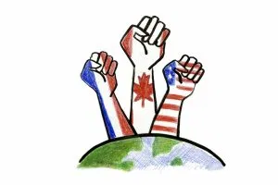
AIM: Which countries pursue the ideals of a nation-state?
DO NOW: What is nationalism?

Slide 33
NATION A group of people bound together by some sense of a common culture, ethnicity, language, shared history, and attachment to a homeland | STATE An area organized into a political unit and ruled by an established government that has control over its internal and foreign affairs, occupies a defined territory on Earth and contains a permanent population | NATION-STATE A state in which the cultural borders of a nation correspond with the state borders of a country

Slide 34
NATIONALISM: loyalty and devotion to a nationality
Nationalism typically promotes a sense of national consciousness that exalts one nation above all others and emphasizes its culture and interests as opposed to those of other nationalities.
Nationalism can unite countries, or force them to separate

Slide 35
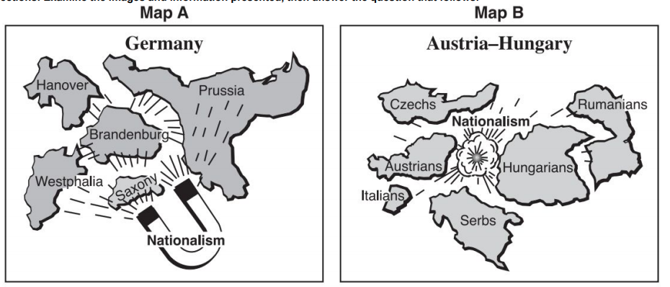

Slide 36
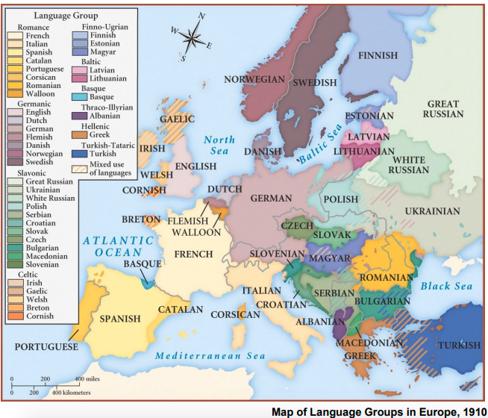

Slide 37
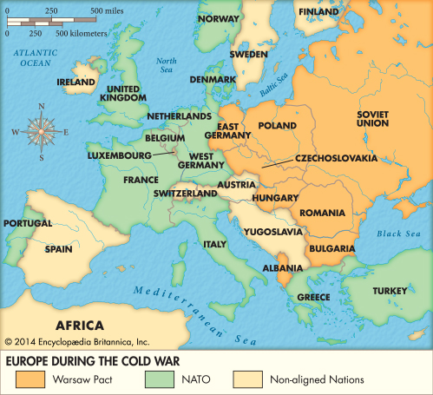
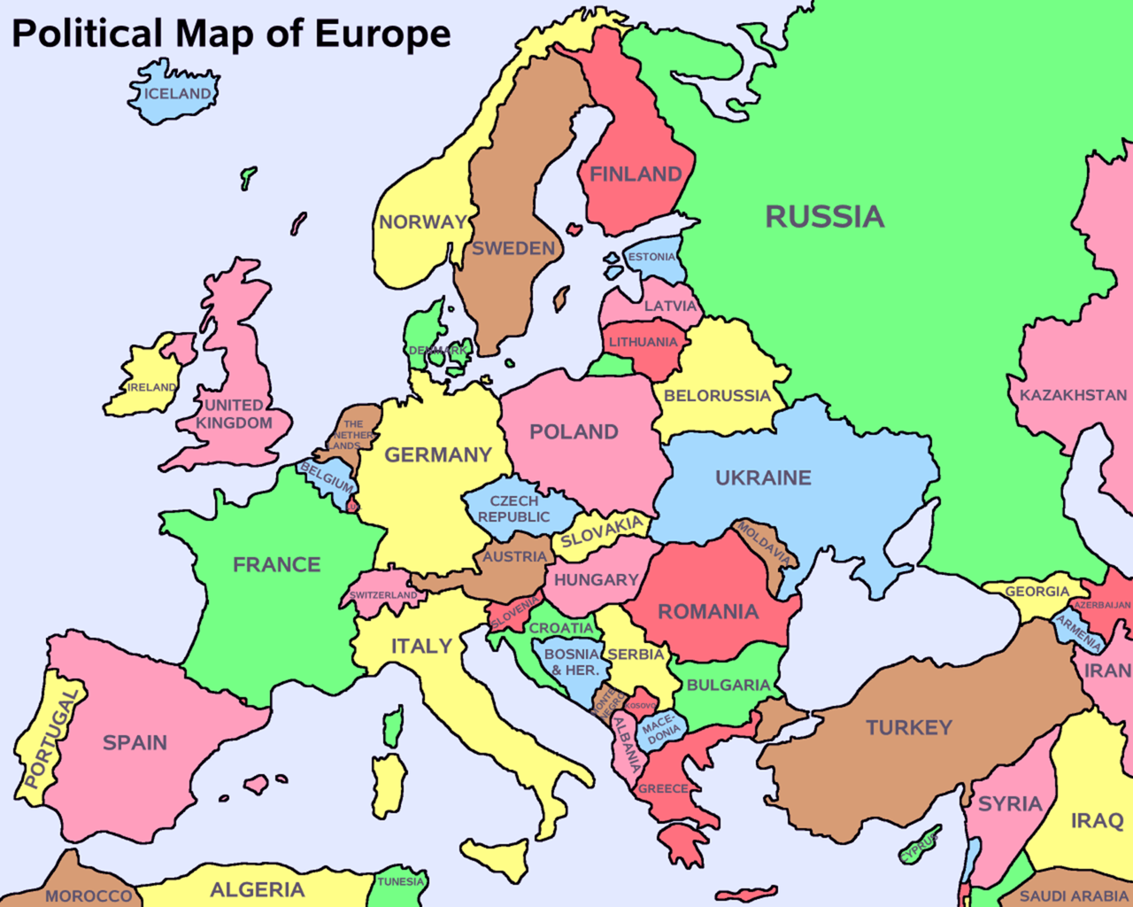

Slide 39
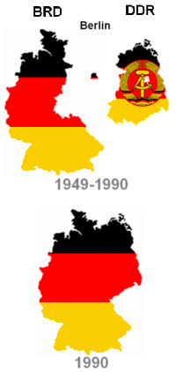
RE-UNIFICATION OF GERMANY
Irredentism: A political movement by an ethnic group or other closely aligned group that aims to reoccupy an area that the group lost. The group’s territorial claims are often based on national, historic, or ethnic affiliations.

Slide 40
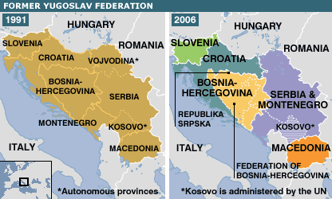
BREAKUP OF YUGOSLAVIA
Balkanization: A contentious process of a state fragmenting into smaller states, which are often hostile or uncooperative with one another

Slide 41
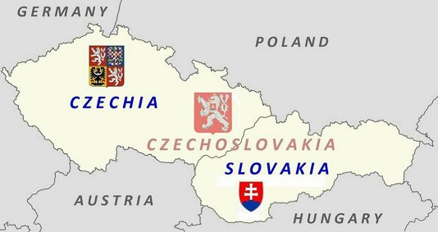
DISSOLUTION OF CZECHOSLOVAKIA
Self-determination: the concept that ethnicities have the right to govern themselves

Slide 42
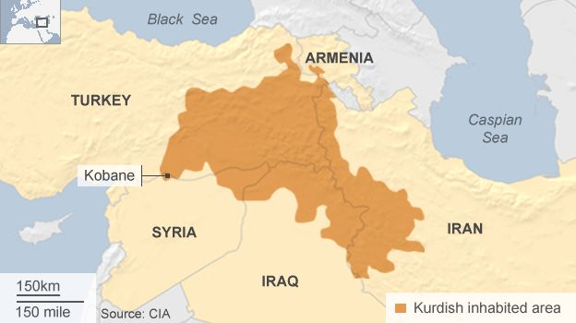
Nation Without a State: Kurds

Slide 43
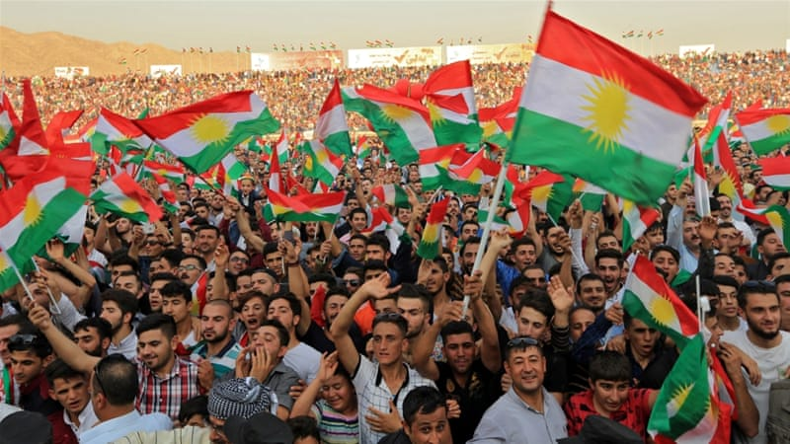

Slide 44
What’s next for the Kurds?
https://www.youtube.com/watch?v=xGiWNAm7ryA

Slide 46
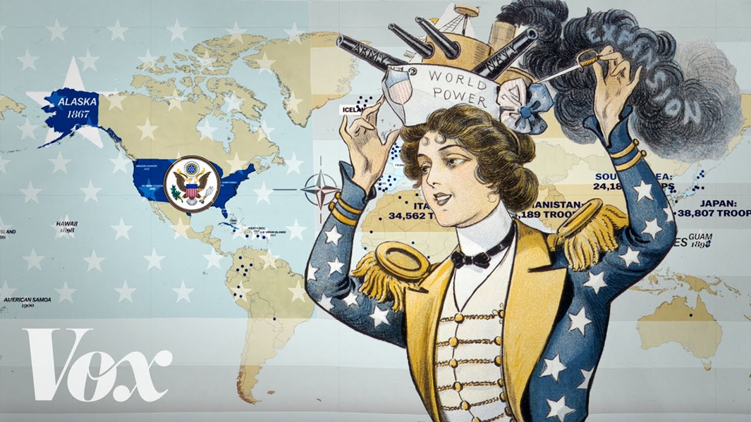
AIM: What gives states power?
DO NOW:
What makes a state (aka country) powerful?
Has our answer to the above question changed over time?

Slide 47
Development of State Concept

Slide 48
DEVELOPMENT OF STATE
 | Definition | Description & Details | Example
City-state
Colony
Imperialism

Slide 49
Political Administration
The branch of geography that deals with boundaries, divisions, and possessions of countries

Slide 50
Political power is expressed geographically as control over people, land and resources.

Slide 51
Colonialism: The practice of establishing political dominance over a people for economic, political, and territorial gain
Imperialism: The practice of taking control of an area that is already politically organized.

Slide 52
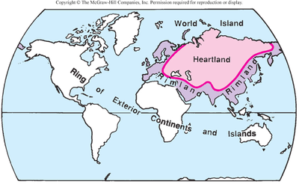
THEORIES OF POWER

Slide 54
ORGANIC
Person
Main Idea
Example

Slide 55
HEARTLAND |  | RIMLAND
 | Person
 | Main Idea/AREA
 | Influence

Slide 56
ORGANIC THEORY
https://www.youtube.com/watch?v=wD32aMptBIo

Slide 57
https://www.bbc.com/ideas/videos/the-heartland-theory---part-two/p071z6h1

Slide 59
SHATTERBELT THEORY
Shatterbelts: a region caught between stronger colliding forces, under persistent stress, and often fragmented by aggressive rivals.
Multiple countries caught up in a conflict over the territory

Slide 60
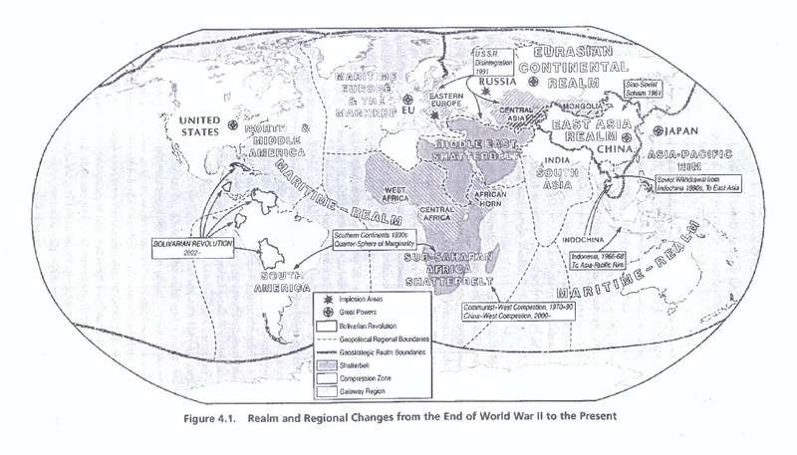
SHATTERBELT THEORY
Examples:
Eastern Europe, Vietnam during Cold War
India and Pakistan over Kashmir

Slide 61
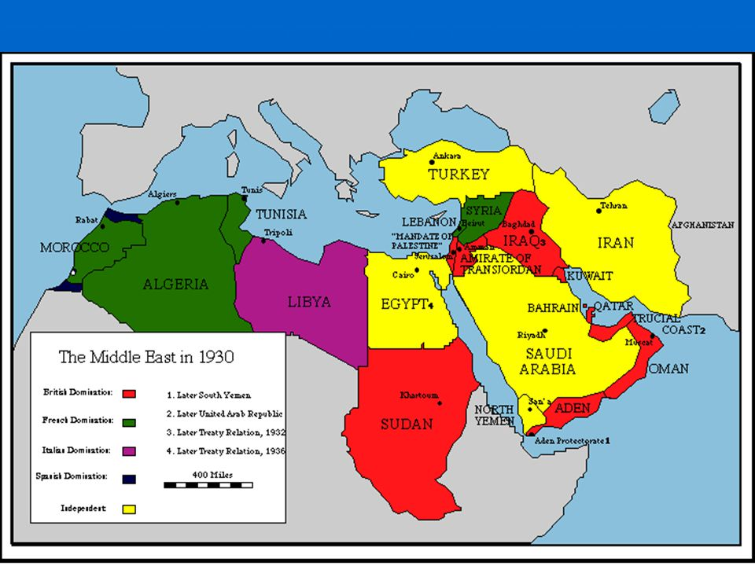
SHATTERBELT THEORY
Cohen’s theory predicted that armed conflicts after 1950 would likely occur in areas within the Inner Crescent or Middle East

Slide 62
Choke Points: In military strategy, a choke point is a geographical feature on land such as a valley, defile (narrow pass or gorge between mountains) or a bridge, or at sea such as a strait, which an armed force is forced to pass, sometimes on a substantially narrower front and therefore greatly decreasing its combat power, to reach its objective.
A choke point can allow a numerically inferior defending force to thwart a larger opponent if the attacker cannot bring superior numbers to bear.

Slide 63
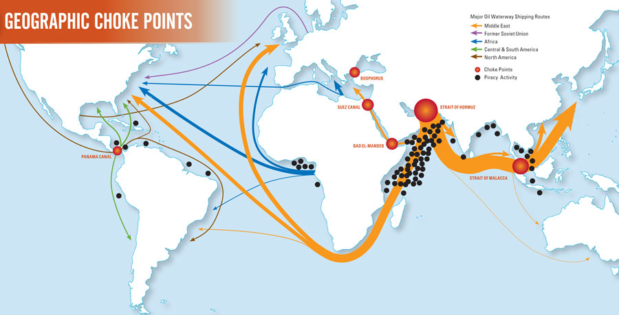

Slide 64
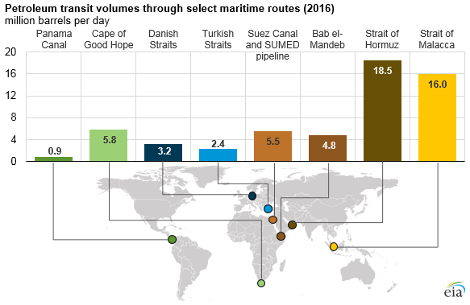

Slide 65
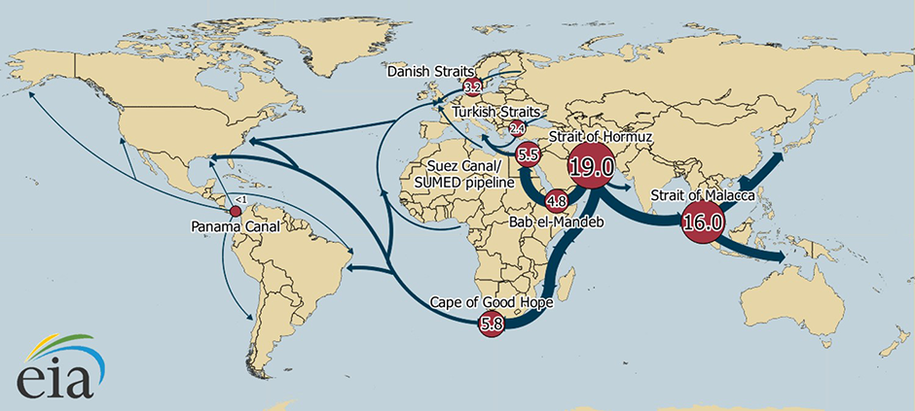

Slide 66
https://www.brinknews.com/world-oil-trade-hinges-on-these-8-vulnerable-chokepoints/

Slide 67
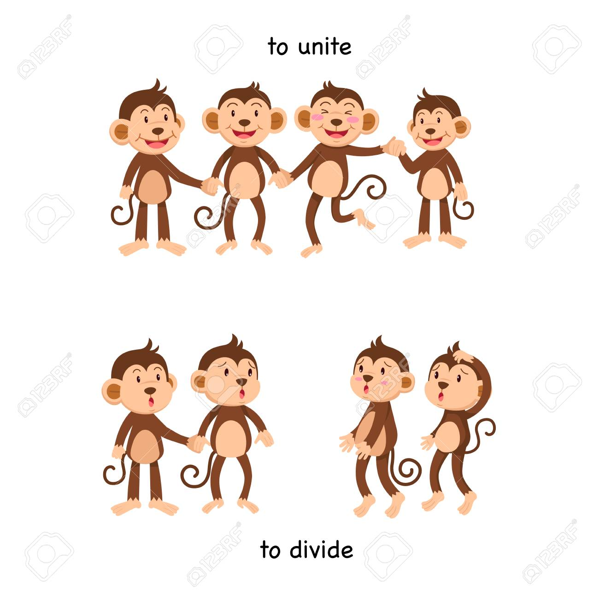
AIM: WHAT FACTORS INFLUENCE THE VIABILITY OF A STATE?
Do Now: Brainstorm factors that unite Americans as well as factors that divide Americas.

Slide 68
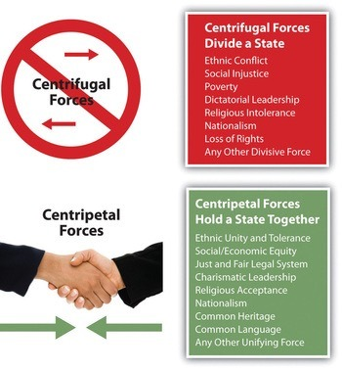
Centripetal vs. Centrifugal Forces
UNITING & DIVIDING FACTORS

Slide 69
CENTRIPETAL
What is a centripetal force?
A centripetal force is a force or attitude that tends to unify people and enhance support for a state.
They provide stability, strengthen the state, help bind people together, and create solidarity.

Slide 70
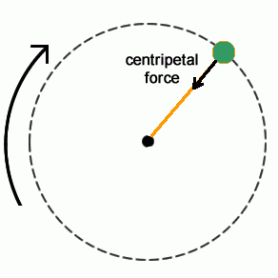
The term centripetal force comes from the Latin words centrum, meaning "center", and petere, meaning "tend towards" or "aim at". They are forces that unite and bind a country together - such as a strong national culture, shared ideological objectives, and a common faith.

Slide 71
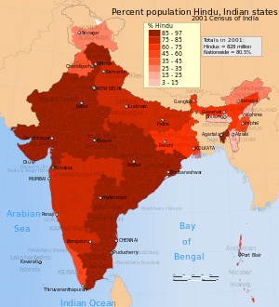
EXAMPLES

Slide 72
CENTRIFUGAL
What is a centrifugal force?
It is a force or attitude that tends to divide a state.
Centrifugal forces destabilize and weaken a state by disrupting the internal order of the state.

Slide 73
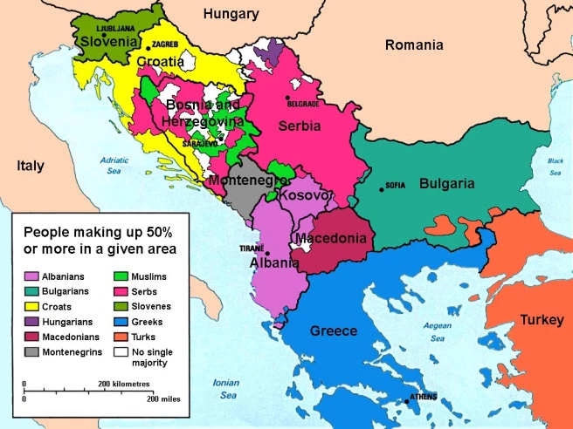
CENTRIFUGAL
Centrifugal forces lead to Balkanization: the process by which a state breaks down through conflicts among ethnicities.
Leads to devolution: which is also the breaking apart of a state.

Slide 74
EXAMPLES

Slide 75
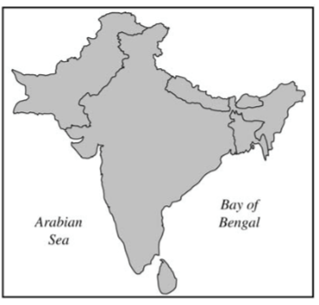
SAMPLE FRQ

Slide 76
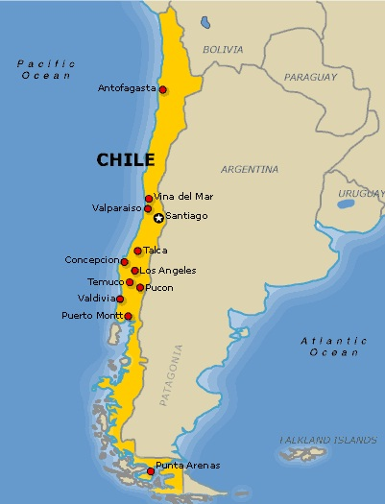
AIM: How can I describe a state’s shape?
DO NOW: What causes states to be shaped in certain ways? Try to think of at least one factor that helps determine the shape of a state.

Slide 77
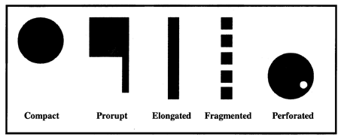
5 Basic State Shapes

Slide 78
COMPACT STATES
Description
The distance from the center to any boundary does not vary significantly
advantage
EFFICIENT
good communication to all regions
disadvantage
Usually small states
may not have as many natural resources

Slide 79
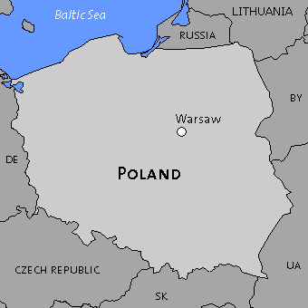
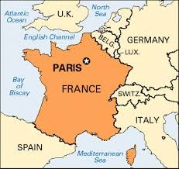
COMPACT STATE

Slide 80
PRORUPTED STATES
Description
Otherwise compact with large projecting extension
advantage
Provide a state with access to natural resources
Separate two states that would share a boundary
disadvantage
Some regions may be isolated or hard to reach

Slide 81
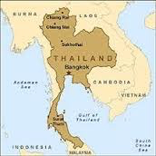
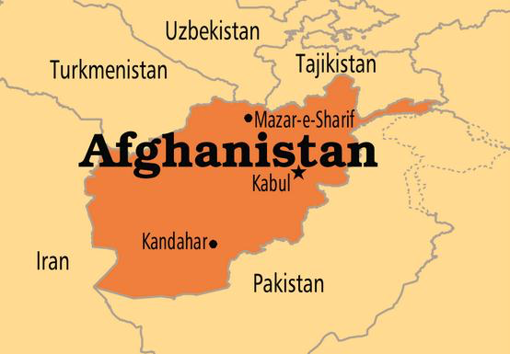
PRORUPTED STATE

Slide 82
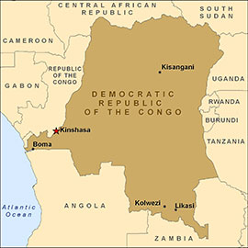
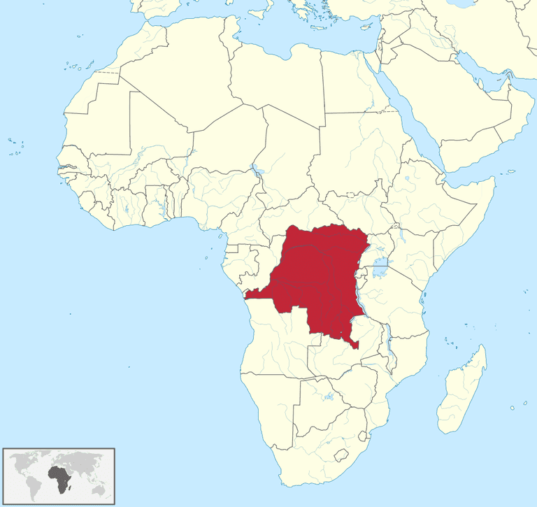

Slide 83
ELONGATED STATES
Description
Long, narrow shape
advantage
Variation of landscapes and resources through your state
disadvantage
Poor internal communication

Slide 84
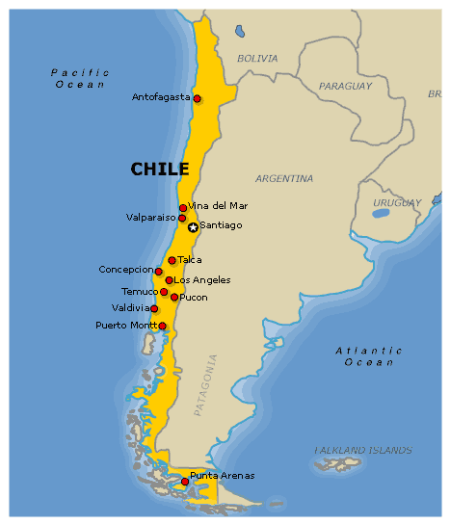
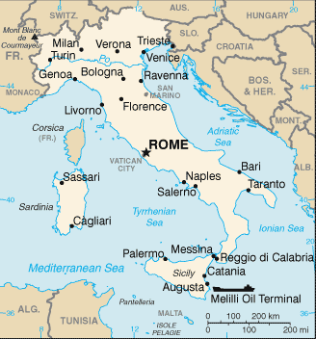
ELONGATED STATE

Slide 85
FRAGMENTED STATES
Description
Several discontinuous pieces of territory
can be separated by water or intervening state
advantage
Variation of landscape,access to resources
disadvantage
Difficult communication,
No unity, high cost

Slide 86
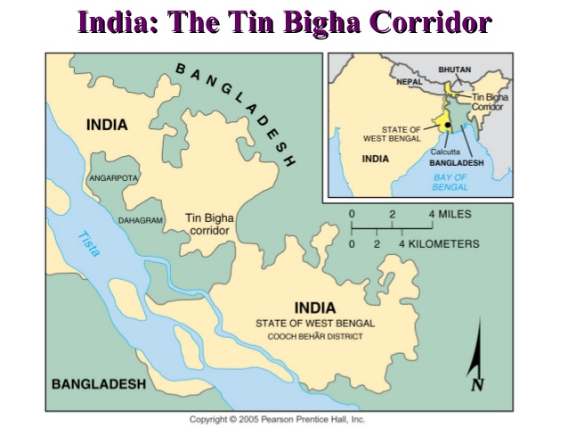
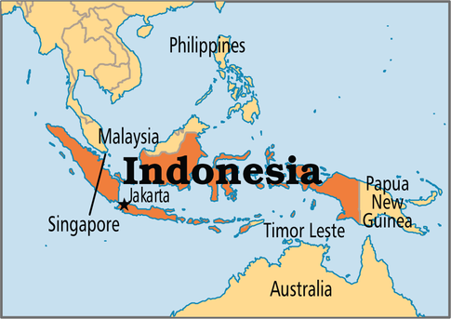
FRAGMENTED STATE

Slide 87
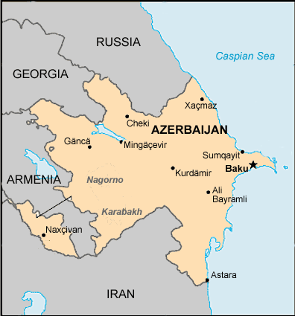

Slide 89
PERFORATED STATES
Description
State that completely surrounds another one
advantage
Can control smaller state (if good relations)
disadvantage
Can be Hostility

Slide 90
PERFORATED STATE

Slide 92
LANDLOCKED STATE
A country that does not have direct access to the sea due to being surrounded by neighboring states

Slide 95
EXCLAVE
A portion of a state that is geographically separated from the mainland by another country or countries

Slide 96
ENCLAVE
a territory, or a part of a territory, that is entirely surrounded by the territory of one other state.

Slide 98
UAE
OMAN

Slide 100
ENCLAVE VS. EXCLAVE
Many exclaves are also enclaves.
Unlike an enclave, an exclave can be surrounded by several states.

Slide 102
Countries within Countries
https://www.youtube.com/watch?v=Vui-qGCfXuA

Slide 103
HOMEWORK

Slide 105
AIM: How are states separated?
DO NOW: What divides states? How do you know where one ends and one begins? Think of an example!

Slide 106
BOUNDARY
FRONTIER
A state is separated from its neighbors by a boundary, an invisible line marking the extent of a state’s territory.
Line
Brings neighboring states into direct contact
Historically, frontiers rather than boundaries separated states.
A frontier is a zone where no state exercises complete political control
Area
Provides some separation

Slide 107
BOUNDARIES
Physical
Political
Geometric
Cultural
Fortified
Antecedent
Subsequent
Superimposed
Relic

Slide 108
BOUNDARIES
Physical Boundaries: A boundary based on the geographical features of the Earth’s surface.
Coincide with features on the natural landscape
Good because they can be seen both on a map and on the ground

Slide 109
PHYSICAL BOUNDARIES
MOUNTAINS
Difficult to cross
Limit contact
Rather permanent
Sparsely inhabited

Slide 110
PHYSICAL BOUNDARIES
DESERT
Difficult to cross
Sparsely inhabited
Common in Africa and Asia

Slide 111
PHYSICAL BOUNDARIES
WATER
Rivers, lakes, oceans
Protection against attack
Disagree over boundaries within bodies of water

Slide 113
BOUNDARIES
Political boundary: An invisible line that marks the outer limits of a state’s territory.

Slide 114
BOUNDARIES
GEOMETRIC BOUNDARY: A boundary created by using lines of latitude and longitude and their associated arcs.

Slide 117
BOUNDARIES
CULTURAL BOUNDARY (ethnographic): follow the distribution of cultural characteristics

Slide 118
CULTURAL BOUNDARIES
RELIGIOUS
Religion is used to draw the boundary line
Examples: India & Pakistan, Northern Ireland

Slide 120
CULTURAL BOUNDARIES
LANGUAGE
Helps distinguish nationalities, most used in Europe
Examples: France, Germany, Italy

Slide 121
BOUNDARIES
DEMARCATION = Boundary is marked on the ground
Engineers and construction workers involved
Stone pillars, walls, etc

Slide 125
BOUNDARIES
FORTIFIED = When a state creates a wall or physical boundary

Slide 126
Egypt/Israel

Slide 131
a. Examples
U.S.–Mexico wall
Berlin Wall (East Berlin–West Berlin)
North Korea–South Korea Demilitarized Zone

Slide 132
b. Purpose
U.S.–Mexico wall: to slow/control the flow of illegal immigrants/goods from Mexico
Berlin Wall (East Berlin–West Berlin): to prevent East Germans from fleeing to the West
North Korea–South Korea Demilitarized Zone: to act as a buffer zone in order to reduce the likelihood of violence
Israel–Palestine: to reduce the threat of terrorist activity

Slide 133
c. Consequences
SOCIAL/POLITICAL
Increase tension between countries
More isolation
Less cultural diffusion
Stigmatize excluded population
Illegal crossing more dangerous
Separation of families
Reduces foreign influence
Increase nationalism
More protection

Slide 134
c. Consequences
ECONOMIC
Cost of construction, maintenance
Creates jobs: construction, maintenance, staffing
Reduces flow of illegal goods
Reduces flow of illegal labor
Loss of cheap labor
Increased cost of smuggling

Slide 135
c. Consequences
ENVIRONMENTAL
Interrupts migration of species
Impact on natural habitats because of walls/new routes
Visual scarring of landscape

Slide 136
Boundary Evolution
Another way to classify boundaries depends not just on how they were created, but on how they evolved over time

Slide 137
ANTECEDENT BOUNDARY
Existed before human cultures developed into their current forms
usually physical

Slide 138
SUBSEQUENT BOUNDARY
Evolves as the cultural landscape takes shape
Developed because of settlement patterns

Slide 139
SUPERIMPOSED BOUNDARY
Forcibly put on landscape by an outside party,
ignores cultures

Slide 140
Example: African countries

Slide 142
RELICT BOUNDARY
No longer functions as boundary, reminder a line once divided space
Example: Berlin Wall, Great Wall of China

Slide 143
Why do boundaries matter? Impact of superimposed boundaries

Slide 144
US CANADA border
https://www.youtube.com/watch?time_continue=4&v=qMkYlIA7mgw

Slide 145
Bizarre Borders
https://www.youtube.com/watch?v=tal9heuk8xc

Slide 147
AIM: When do states disagree over boundaries?
DO NOW: conflicts over boundaries?

Slide 148
Are there boundaries in the Ocean? The oceans cover 71 percent of the Earth's surface

Slide 149
Law of the Sea: set of UN laws establishing states’ rights and responsibilities concerning the ownership and use of the Earth’s waters and their resources.

Slide 150
Territorial Waters: 12 nautical miles from baseline, sovereign territory of the state. Controls air space above and seabed below
Contiguous waters: up to 24 nautical miles, states may exercise the control necessary to prevent others from infringing its customs, immigration and other laws

Slide 151
Exclusive economic zone (EEZ): A sea zone over which a state has special rights over the exploration and use of marine resources stretching 200 nautical miles from the coast.

Slide 152
Median-line principle: A line that is drawn in the water equidistant from each competing party to settle a question of sea resource access (when there’s an EEZ conflict)

Slide 153
Admiralty Law: a part of international law that dictates legal procedures on the high seas. Beyond the 200-mile limits, international fishing fleets can hook or net whatever ocean life they choose and in unregulated amounts.

Slide 154
International Whaling Commission: 1986 law bans whale hunts. Norway and Japan still hunt whales, claiming their hunts are for scientific research. This claim is heavily criticized by environmental organizations who state that whale meat still makes its way to market in these countries.

Slide 155
BOUNDARY CONFLICTS

Slide 156
RECAP: Boundaries
Frontiers
Physical boundaries
Geometric boundaries
Cultural boundaries: language, religion
Antecedent
Subsequent
Superimposed
Relic

Slide 157
Definitional/Positional boundary disputes are fights over the language of the border agreement in a treaty or boundary contract
Ambiguous phrases

Slide 158
Locational/territorial boundary disputes occur when the conflicting parties agree on the definition but not on where the boundary exists on the Earth of the map (The interpretation is in dispute)
Dispute over delimitation: The process of mapmakers placing the boundary on the map.

Slide 159
Operational boundary disputes are conflicts over the way a boundary should operate or function
Example: US/Mexico - if migration should be allowed across the border.

Slide 160
Allocational boundary disputes are fights over natural resources that may not be divided by the border
Example: mineral deposits, fertile farmland, fishing groups, natural gas or oil reserves

Slide 161
https://www.nationalgeographic.com/culture/2018/07/grey-zone-disputed-border-us-canada-news/

Slide 166
DISPUTED BOUNDARIES PROJECT

Slide 167
KASHMIR
SAMPLE PPT

Slide 169
Kashmir Conflict Quick Facts
SAMPLE PPT
Main conflict:
Who controls the territory?
Ethnic conflict: Muslim vs. Hindus
One of the longest running conflicts in the world today
Ongoing violence has killed more than 47,000 people since 1989

Slide 170
How did it start?
SAMPLE PPT
Legacy of colonialism
1947 India won its independence, India and Pakistan were created as two separate states

Slide 171
SAMPLE PPT
Both countries agree to allow Kashmiris to decide their own future
Pakistan forces invade Kashmir
Kashmir chose India → war erupted

Slide 172
Kashmir – symbolic importance
SAMPLE PPT
Indian authorities wanted to show that they could guarantee the rights of Muslims in a secular state, but Kashmir is also key to Pakistani identity as a homeland for Muslims after partition

Slide 173
SAMPLE PPT
In 1949, India and Pakistan signed an agreement to establish a ceasefire line as recommended by the UN and the region became divided
“Line of Control”

Slide 174
Why is there still conflict?
SAMPLE PPT
Armed conflicts occurred on and off in the decades after the independence movement
Both countries have maintained a fragile ceasefire since 2003, according to the Council on Foreign Relations, although the two rivals regularly exchange fire across the border.

Slide 175
IMPACT
SAMPLE PPT
US President Donald Trump has offered to mediate in the crisis - an overture that Delhi has rejected
Still fierce tensions between India and Pakistan over the region
Should Kashmir (mostly Muslim) realign with India or become an independent state?

Slide 176
SAMPLE PPT

Slide 179
AIM: How are states organized? Are there boundaries within states?
What can you tell me about the situation in the these countries?

Slide 184
Organization of State
A state’s size and cultural composition are factors in its political situation and internal organization
Governments of states are organized according to one of two approaches – unitary system or the federal system.

Slide 185
UNITARY STATES
Places most power in the hands of one central government who make decisions for entire state
Centralized government

Slide 186
UNITARY STATES
Works best in nation-states with
few internal cultural differences (homogenous)
National unity
Smaller, compact sizes

Slide 187
UNITARY STATES
Example:
Especially common in Europe – UK, Norway, Finland
Japan, China

Slide 188
UNITARY STATES
Multinational states often adopt unitary systems to that the values of one nationality can be imposed on others
Examples: Ghana, Kenya, Rwanda

Slide 193
FEDERAL STATES
Allocates strong power to units of local government within the country
Local governments have authority to adopt their own laws
Boundaries can be drawn to correspond with regions inhabited by different ethnicities
Empowers different nationalities, especially if the live in separate regions

Slide 194
FEDERAL STATES
FEDERAL STATES
Works best in:
Larger states – capital may be too remote to provide effective control over isolated regions
Heterogeneous states (multiple ethnicities, languages, religions)
Example: Belgium

Slide 195
FEDERAL STATES
Examples: United States, Russia, Canada, Brazil, India

Slide 196
FEDERAL STATES
FEDERAL STATES
Heterogeneous states (multiple ethnicities, languages, religions)
Example: Belgium

Slide 200
FEDERAL STATES
CONFEDERAL STATES
A system consisting of a league of independent states, each having essentially sovereign powers.
The central government created by such a league has only limited powers over the states.

Slide 201
UNITARY VS. FEDERAL

Slide 202
Political geographers classify most countries as either unitary states or federal states.
Define unitary state and identify the country that fits the definition.
Explain ONE positive and ONE negative impact of a unitary state.
Identify and explain ONE reason why some countries are governed as federal states.

Slide 203
Positive Impacts:
Standardization of laws and their implementation across the country
Patriotism or pride in one’s country is bolstered due to uniformity

Slide 204
Efficiencies are achieved through less duplication OR faster countrywide implementation of laws or governmental services across multiple scales
Fewer government or taxation agencies, or fewer scales of government or taxation
The potential for corruption of local government reduced
Creation of a national identity that reduces the potential for devolutionary processes

Slide 205
Negative Impacts:
Centralization of power can lead to a disconnect with local areas, minority groups, regional political parties, or disparate regions
Marginalization of local cultures through standardization at a country level

Slide 206
Central government may not effectively provide services on a subnational scale
Decisions and policies of the central government could become dominated by interests of the politically or culturally dominant group
Central government bogged down by competing local problems OR slow response to local issues. (e.g., natural disasters, infrastructure, public services

Slide 207
DEVOLUTION
In recent years, there has been a strong global trend toward federal government. Unitary systems have been sharply curtailed in a number of countries and scrapped altogether in others.

Slide 208
DEVOLUTION
Process of transferring some power from the central government to regional governments
Transfer of power that occurs when a state breaks up, when regions that were once unified in one, central government gain power, and sometimes, independence.

Slide 209
Why federal states?
Advantages:

Slide 210
Advantages of federal states:
Multiple nationalities, ethnicities, or cultures → diverse states devolve power in order to reduce separatist tendencies or to enhance loyalty to the country

Slide 211
Advantages of federal states:
To address devolutionary forces arising from physical, economic, or political differences → federal governments are able to maintain national cohesion by bridging physical or cultural barriers or providing means for resolving conflicts between subnational areas

Slide 212
Advantages of federal states:
Larger countries, or territorial control over large or fragmented area → allow units to provide more effective governmental services to address local issues.
As distance from national capital increases, people tend to feel better served by decision-makers who are closer to home

Slide 213
One Country, Two Systems
Organization of China

Slide 215
AIM: How is the US federally organized?
DO NOW: Do you know how the United States government works?

Slide 217
Federalism: system of government in which powers are divided and shared by a central government and its sub-divisional governments (states)
Delegated powers: powers listed as belonging to the national government
Reserved powers: powers reserved for state governments
Concurrent: powers shared between central and state governments

Slide 219
Representation in Congres

Slide 220
Electoral college

Slide 221
CENSUS
Determines number of people in each state, used to re-apportion members in the House of Representatives
Apportionment is the process by which seats in a legislative body are distributed among administrative divisions entitled to representation.

Slide 222
CONGRESSIONAL DISTRICTS & GERRYMANDERING

Slide 225
WHAT IS GERRYMANDERING?
Definition: drawing political boundaries to give your party a numeric advantage over an opposing party

Slide 228
Gerrymandering Explained
https://www.youtube.com/watch?v=bGLRJ12uqmk

Slide 232
There's a new downloadable font inspired by gerrymandered congressional districts

Slide 233
Ink Blot or District?
https://www.benjerry.com/whats-new/2017/04/district-or-inkblot-quiz

Slide 234
Pennsylvania case
https://www.youtube.com/watch?v=WRqyYokJ97c

Slide 236
In the redistricting that occurred in 2012, voters in Maryland approved a redrawn Third Congressional District, as shown in the map above. A geospatial analysis firm named it the least compact district in the nation.
Identify the political phenomenon represented on the map.
Explain the relationship between redistricting and the census.
Identify and discuss TWO political consequences that could result from redistricting.

Slide 238
How do devolutionary forces impact states?
DO NOW: RECAP

Slide 239
What are Forces that Challenge Sovereignty and Fragment a State?

Slide 240
Sovereignty is the internationally recognized exercise of a country’s power over its people and territory.
A federal state gives local political units like states or provinces within that country a measure of power. Conversely, unitary states are characterized by a strong central government.

Slide 241
Divisive forces threaten a country’s sovereignty by dividing the country and breaking down the central government.
They are called centrifugal forces, and some examples of these forces are religious, ethno-cultural, economic, and spatial differences and can lead to devolution.

Slide 242
What is Devolution? The movement of power from the central government to regional governments within the state or breakup of a large state (balkanization) into several independent ones is known as devolution

Slide 243
Separatism caused by centrifugal force sometimes leads to devolution as the central government ends up giving the separatist group some of its demands to keep the peace.
Separatist groups include the Moros of the Philippines, the Basques of Spain, and the Sikhs in India.

Slide 245
Devolved governments: Devolved territories have the power to make legislation relevant to the area and thus granting them a higher level of autonomy.

Slide 248
Kingdom of Denmark, consisting of Greenland, the Faroe Islands, and Denmark
Greenland, Faroe islands have devolved government

Slide 249
IMPACT OF DEVOLUTION
Formation of new states/governments
More power to regions – local control over policy
Local ethnonationalism → linguistic/religious revival
Regional separatism
Political instability → civil war, hostility, conflict, ethnic cleansing
Economic instability
Mass migration – refugees, emigration

Slide 250
EXAMPLES
RESEARCH PROJECT

Slide 251
Devolutionary pressures result in increased autonomy for a region.
If strong enough, these devolutionary pressures may result in complete balkanization

Slide 252
Breakup of a state:
Former USSR
Yugoslavia/Balkans
Czechoslovakia
Austria-Hungary
Ethiopia-Eritrea
British India
Demand for autonomy:
United Kingdom
Catalonia, Spain
Basques, Spain
Quebec, Canada
Corsica, France
Padania, Italy
Tyrol, Italy
Crimea, Ukraine

Slide 254
AIM: Why do states cooperate with each other?
DO NOW: Give two reasons why states should cooperate with each other in the world.

Slide 255
Supranationalism
Supranationalism is the process of nation states organizing politically and economically into one organization or alliance. Supranational organizations are where three or more countries form an alliance for cultural, economic, or military reasons. These alliances are created so states can reach cultural, economic or military goals they may not be able to reach without relying on one another

Slide 256
Supranationalism
Political, economic and/or cultural cooperation among national states to promote shared objectives
Tendency for states to give up political power to a higher authority in pursuit of common objectives (political, economic, military, environmental)
Venture involving multiple national states with a common goal

Slide 257
Other Examples:
NATO/Warsaw Pact
NAFTA (North American Free Trade Agreement)
UN (United Nations)
OPEC (Organization of Petroleum exporting countries)
African Union (AU)
Arab League
Association of Southeast Asian Nations (ASEAN)
Union of South American Nations (USAN)
Commonwealth of Independent States (CIS)

Slide 258
EUROPEAN UNION

Slide 259
Changes in Europe due to supranationalism

Slide 260
Positives/Benefits of Supranationalism | Negatives/Drawbacks of Supranationalism

Slide 261
European Union
http://www.telegraph.co.uk/news/2016/06/20/what-is-the-eu-why-was-it-created-and-when-was-it-formed1/

Slide 262
Brexit Guide
https://www.youtube.com/watch?v=7eoDwvl0QGk

Slide 263
The United Nations
https://www.youtube.com/watch?v=QoIafzc0k74

