Slide 1
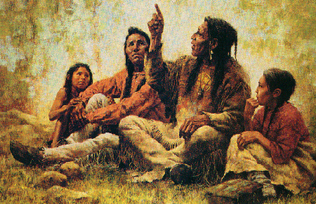
Gabrielino
By Chloe and Aneela

Slide 2
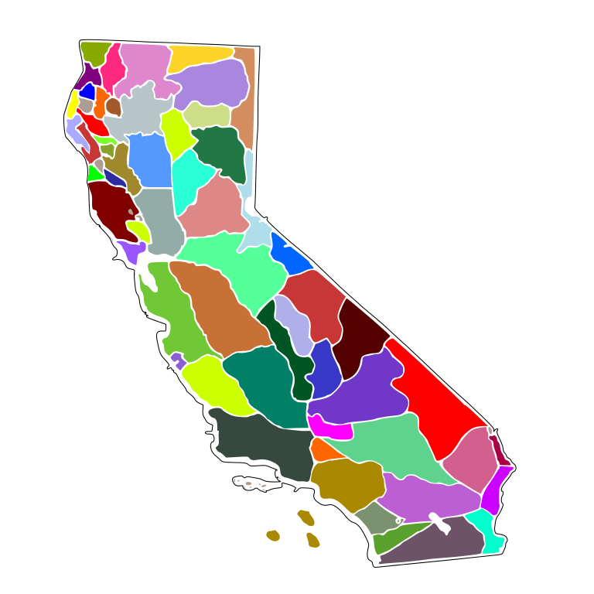
Location
The Gabrielino lived in the Southern Western part of California.They lived in the Topanga Valley South to Laguna Beach part of California. They lived near San Bernardino counties, Orange counties, Channel Island, and near Los Angeles. They lived along the coast and they live part of Western Riverside. The Gabrielino tribe location is what today is Los Angeles.

Slide 3
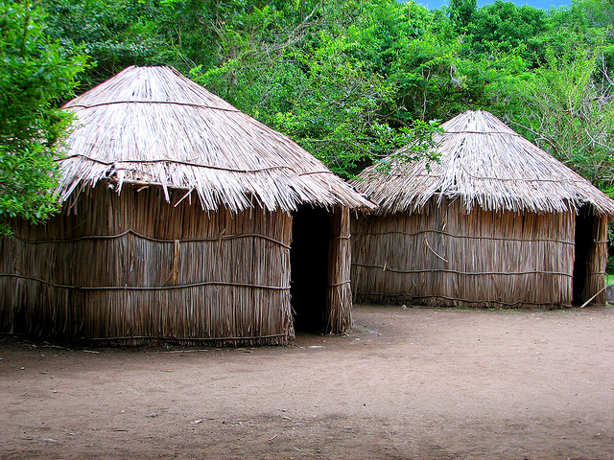
Shelter
The homes of the Gabrielino tribe protected them from the environment They made their homes out of bent tree sapling, placing upright in a circle, and bending them to meet in the middle. Each family had a leader and some houses are large enough to hold 50 or 60 people. Three or four families can live in one house and they had a sweat house.

Slide 4
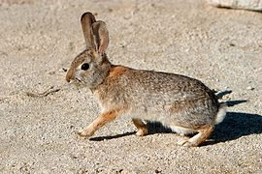
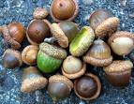
Food
The Gabrielino tribe used their land to find food in order to survive. There foods that they ate tuna, swordfish, sharks, small fish, shellfish, sea mammals, sea birds, sea lions, harbor seals, sea otters, elephant seals, rock scallop, mussels, limpets, and sea urchins from the water. They ate acorns, pinon nuts, sage, berries, deer, rabbit, birds, snakes, and small rodents from land.

Slide 5
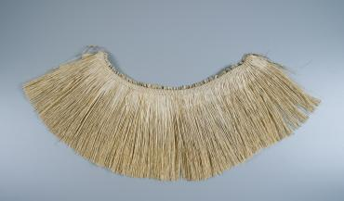
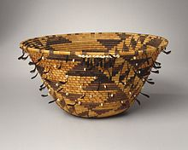
Culture
The culture of the Gabrielino tribe was unique and interesting. The
Gabrielino tribe were expert basket makers in their culture. The
women wore skirt woven of tule. The men and children usually did not wear any clothing. The people of the Gabrielino tribe would paint their faces when they attended ceremonies.

Slide 6
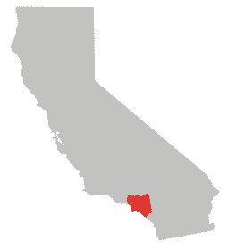
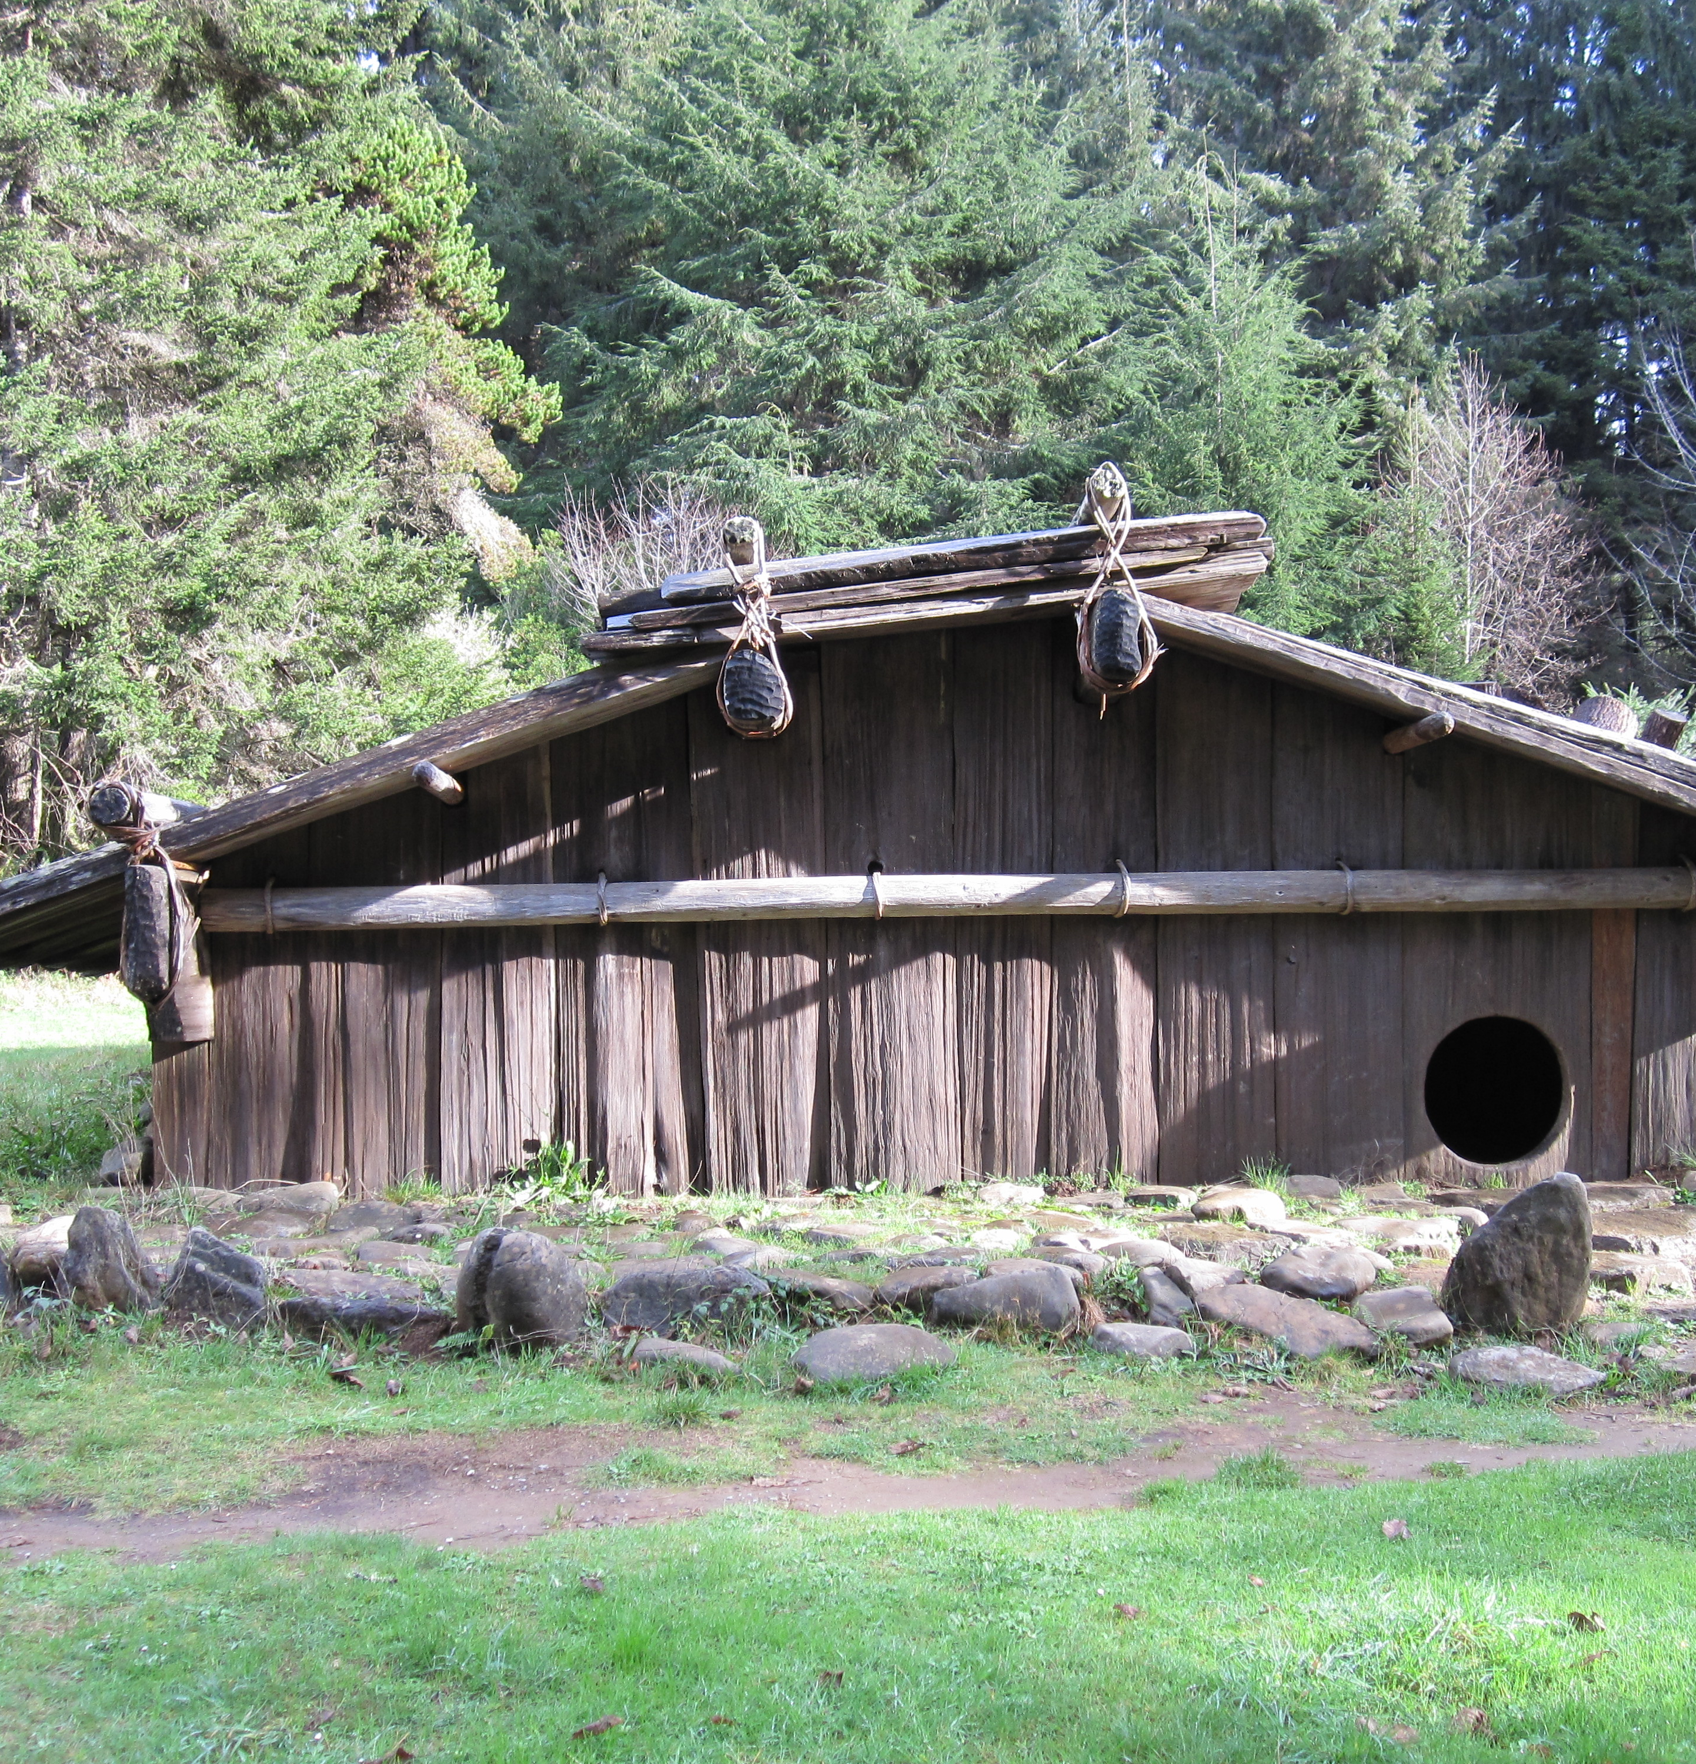
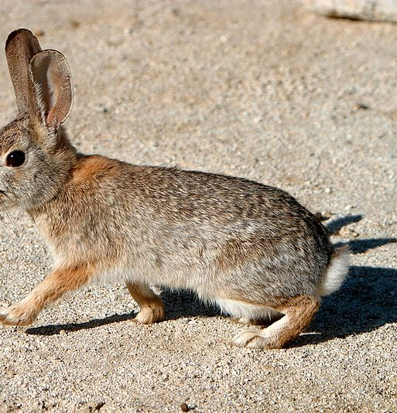
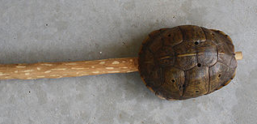
Concluding
In conclsion, I learned about the cultures, foods, shelters, and geographical location about the Native American tribe, the Gabrielino.

