Slide 1
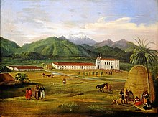
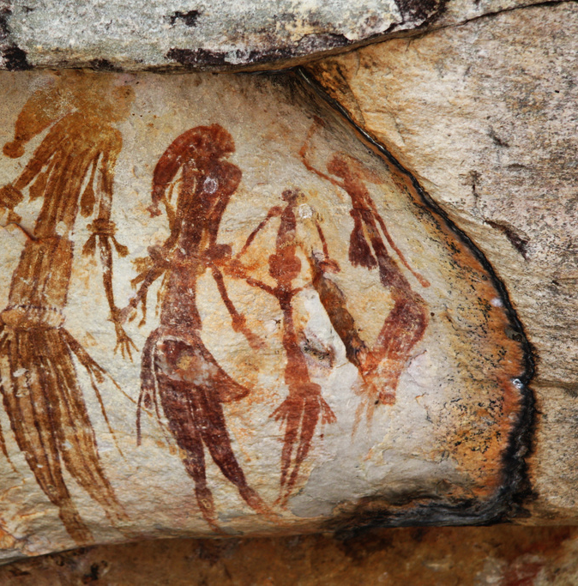
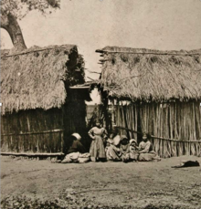
Gabrielino
By Danett Sandoval
This Photo by Unknown author is licensed under CC BY-SA.

Slide 2
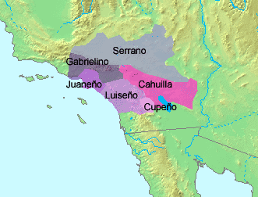
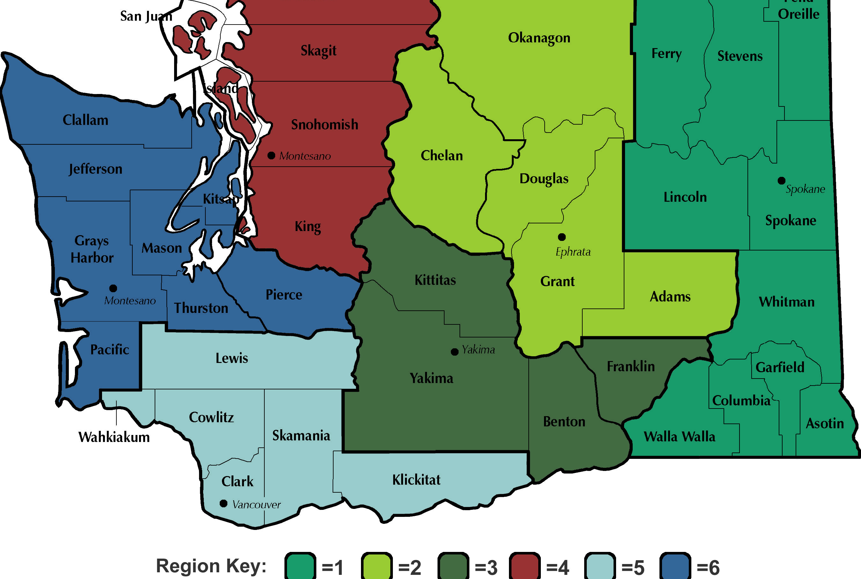
Location
The Gabrielino lived on islands and rivers. They lived along the coast and built their homes in shelters on the coast. They built and lived along the rivers and streams. They also lived near what is today Topanga south , Laguna Beach, and the Los Angeles River.

Slide 3
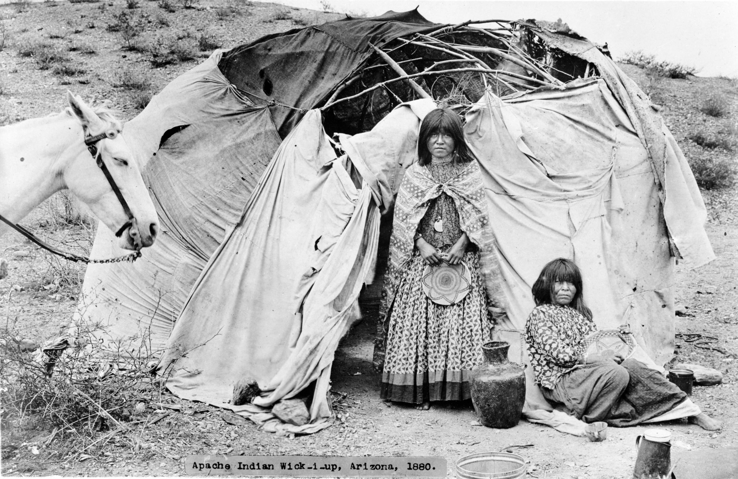
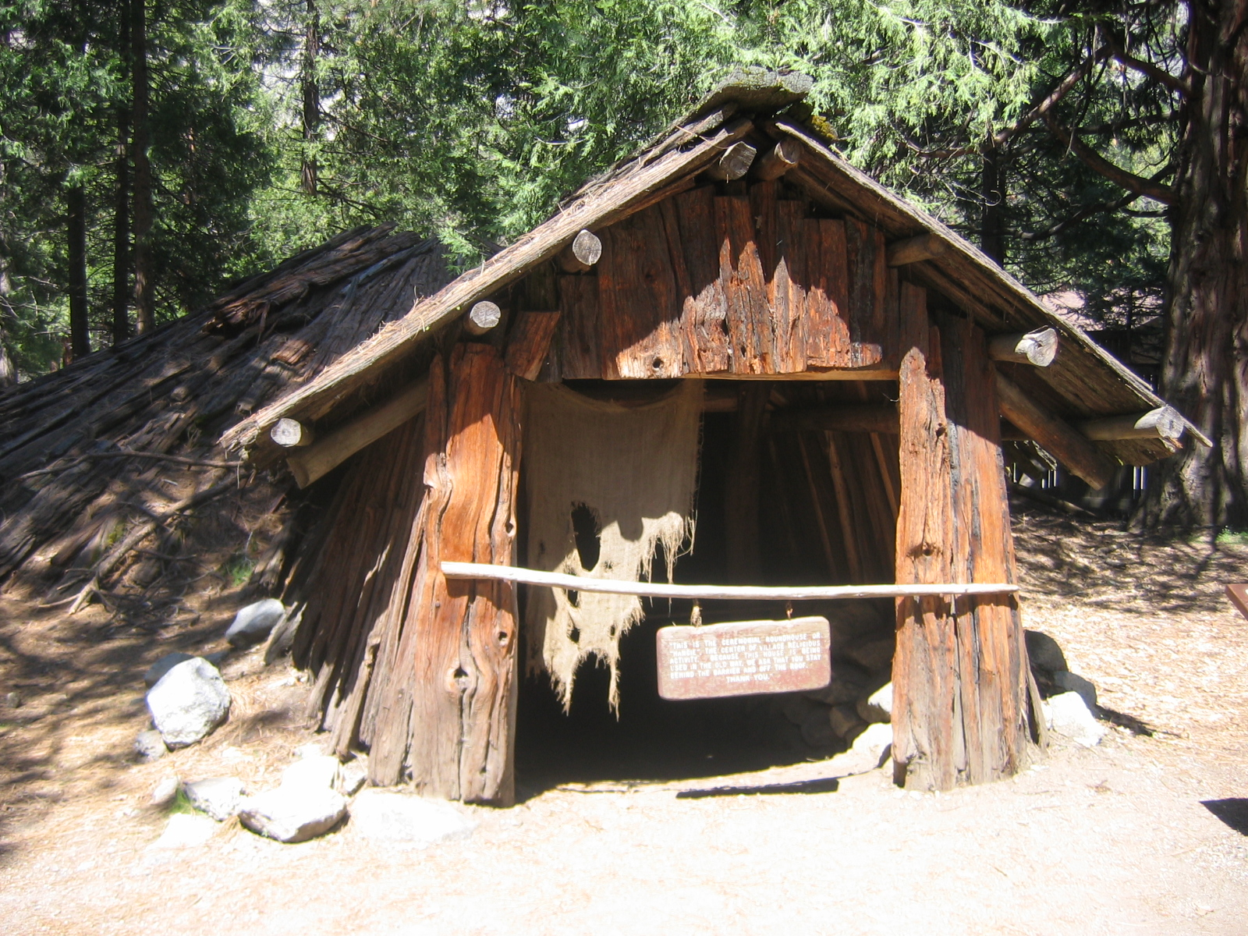
Shelter
The Gabrielino shelters were made from natural resources. To make homes they had to place poles upright in a circle and bend them into the middle. Some things were made with tule, reeds or with mats woven from tule. There was a type of sweathouses where the men met to talk and sweat . Their homes could hold up to 50-60 people.

Slide 4
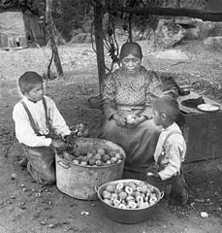
Food
The food that the Gabrielino ate was plentiful. They ate tuna, sword fish, sharks, shellfish, sea mammals and sea fish. They also ate pinon nuts, sage, berries, deer, birds, snakes, rabbits. From the ocean they also ate sea lions, harbor seals, sea otters, and elephant seals which were plentiful.

Slide 5
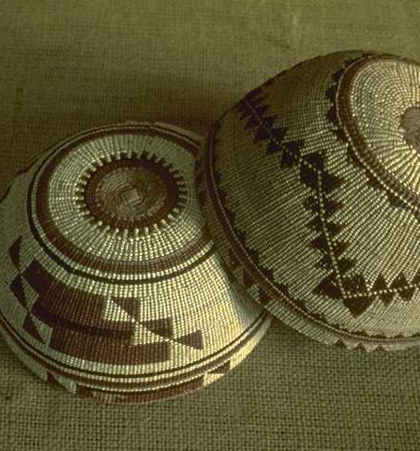
Culture
The Gabrielino culture uses many types of natural resources . The women made baskets that were so tight that it could hold water and babies. They make a wicker seed beating tool for plants and seeds . The women also make purses or bags woven from some types of plants. Tattooing is most popular for the Gabrielino women.
This Photo by Unknown author is licensed under CC BY-SA.

Slide 6
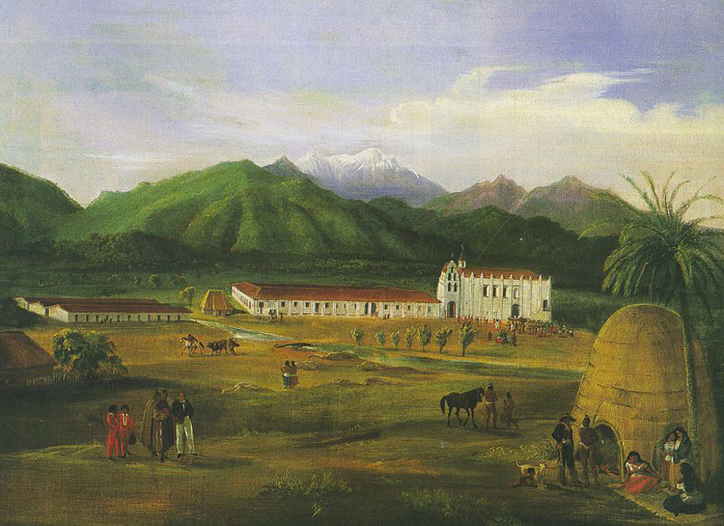
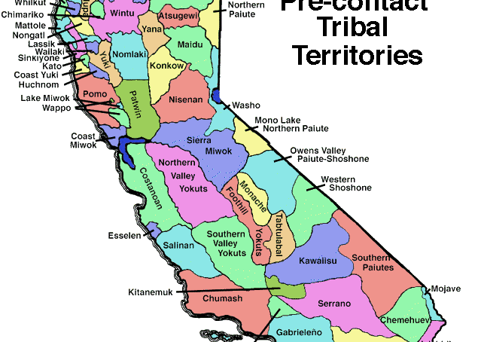
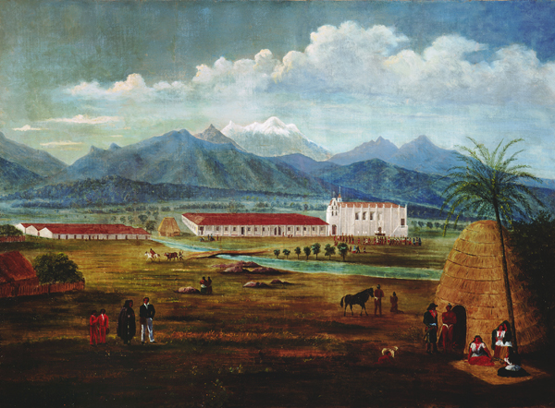
This Photo by Unknown author is licensed under CC BY-SA.
This Photo by Unknown author is licensed under CC BY-SA.
This Photo by Unknown author is licensed under CC BY-NC-ND.
This Photo by Unknown author is licensed under CC BY-SA.

