Slide 1
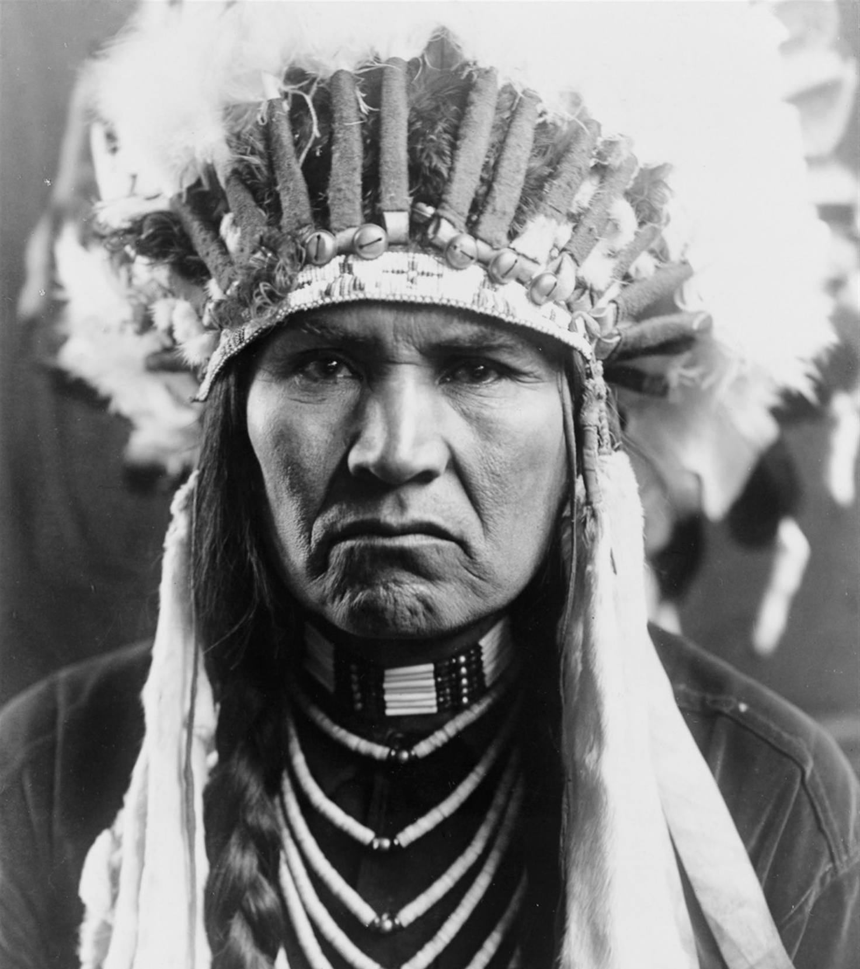
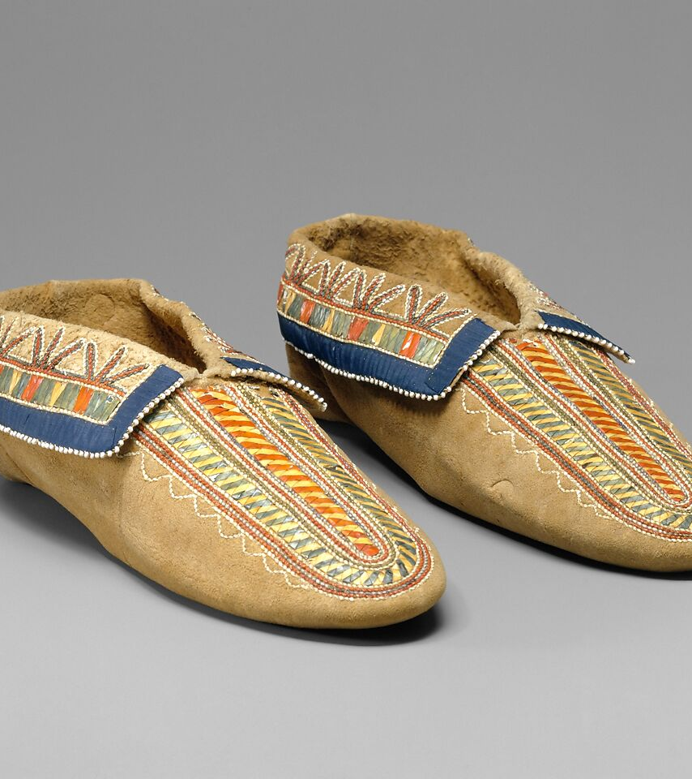
The Seneca
By Emily Cerda

Slide 2
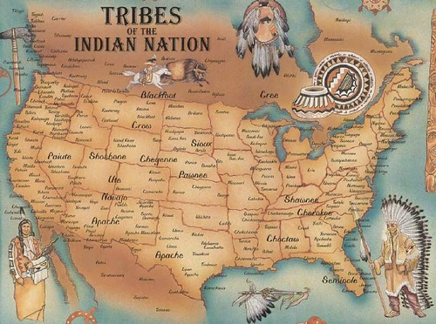
Location
The Seneca lived in the western part of New York where the climate was cold in the winter and mild in summer. They also lived in Oklahoma.
This Photo by Unknown author is licensed under CC BY.

Slide 3
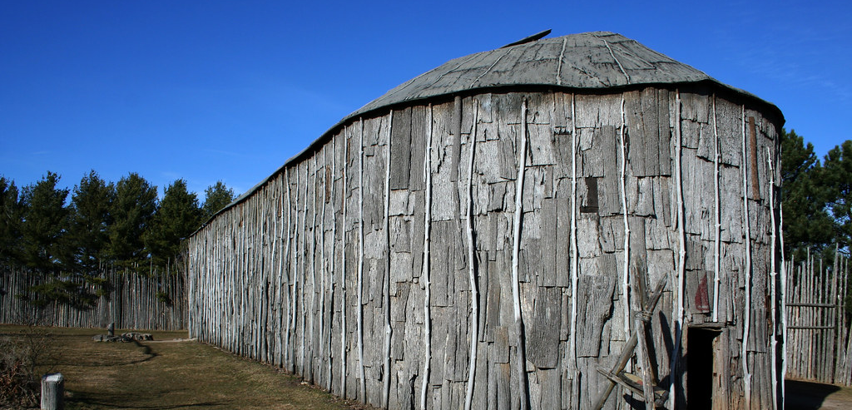
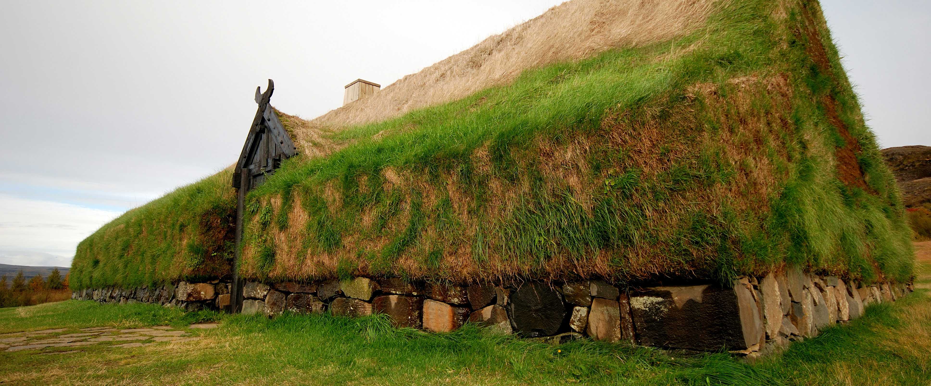
Shelter
This Photo by Unknown author is licensed under CC BY-SA.
The Seneca lived in longhouses that were rectangular buildings. Several families could live in it. The longhouses are made of tree bark and tree branches.
This Photo by Unknown author is licensed under CC BY-SA.

Slide 4
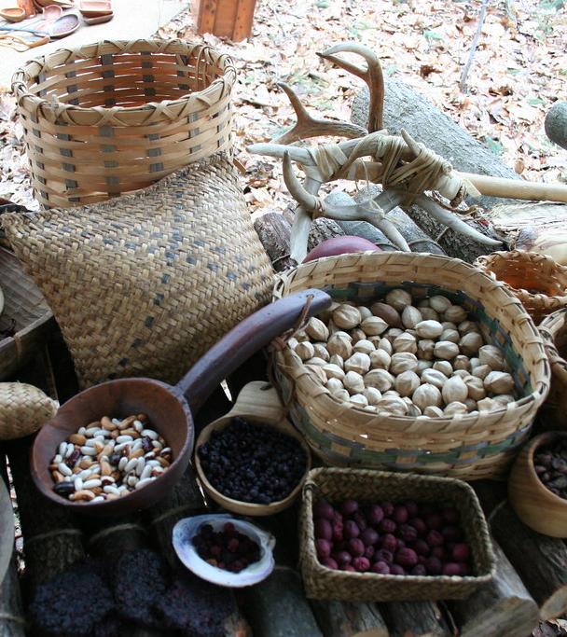
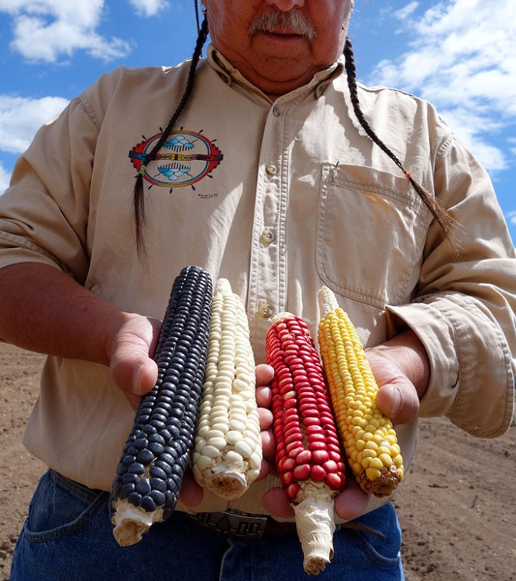
Food
The Seneca cooked food like cornbread, soups, and stews. They also hunted for food like deer and elk. The women also gathered ,corn, and beans.
This Photo by Unknown author is licensed under CC BY-NC-ND.
This Photo by Unknown author is licensed under CC BY-NC-ND.

Slide 5
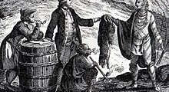
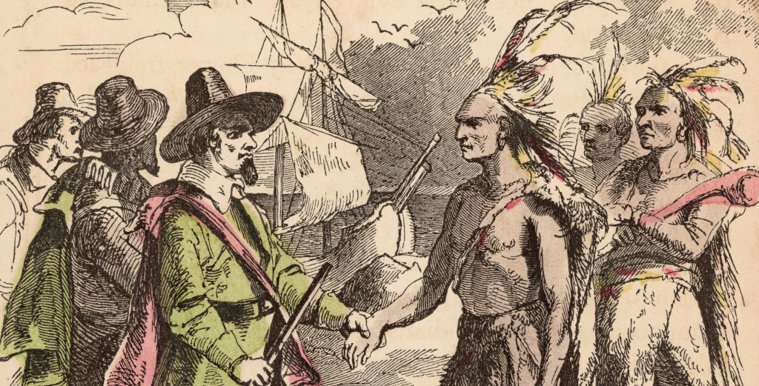
Culture
In the Seneca's culture was that they traded furs for metal tools with the European traders in the 1600's.The Seneca's tribe was always ruled by women.
This Photo by Unknown author is licensed under CC BY-NC-ND.
This Photo by Unknown author is licensed under CC BY-SA.

Slide 6
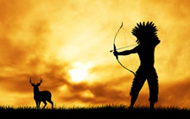
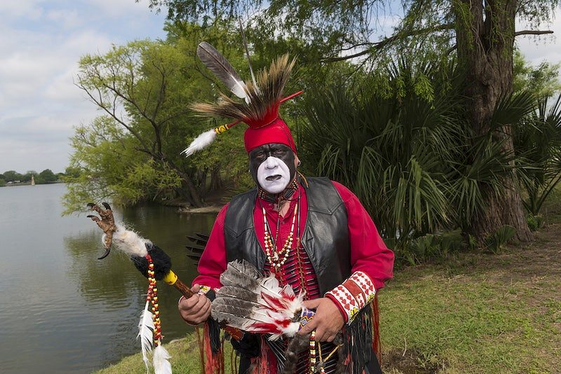
Tools
The Seneca used a bow and arrow to get their food like deer and elk.

Slide 7
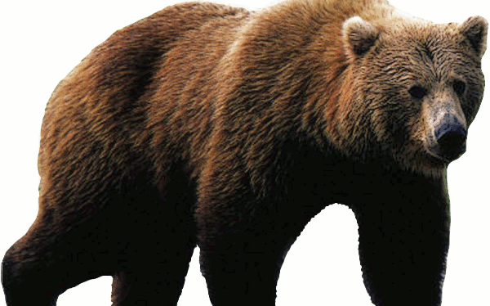
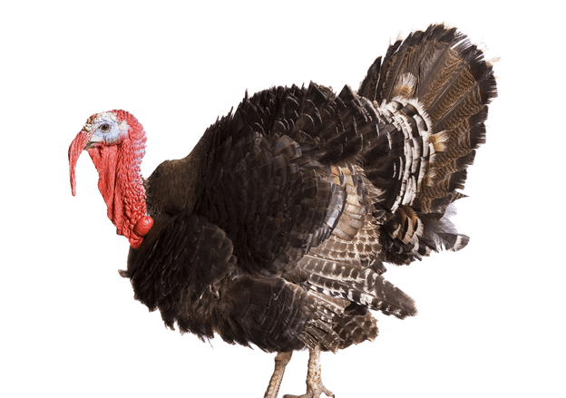
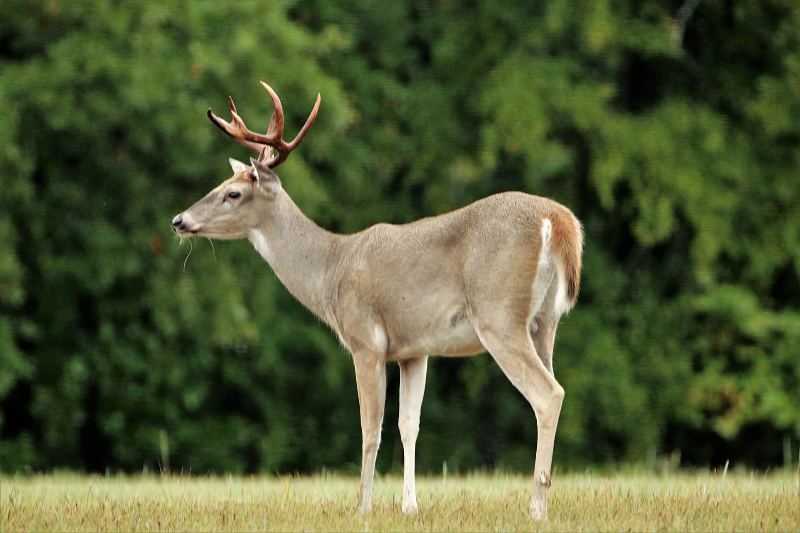
Animals
The kind of animals that live near the Seneca are deer, bears, and turkeys.

Slide 8
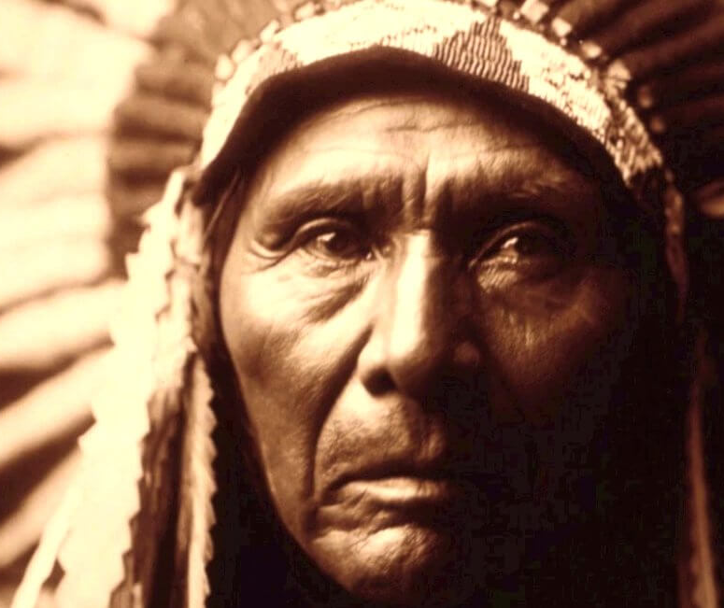
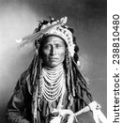
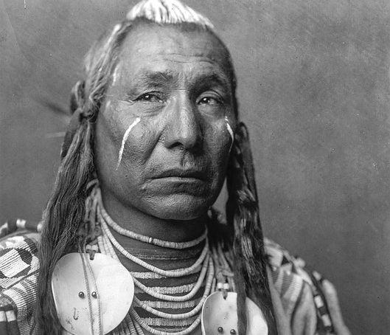
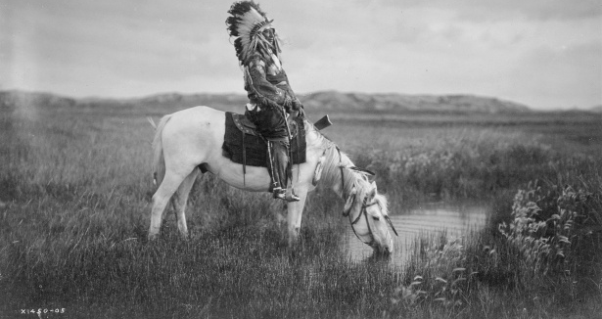
The End
Thank you for reading. Hope you liked my power point.
This Photo by Unknown author is licensed under CC BY.

